Slide 1
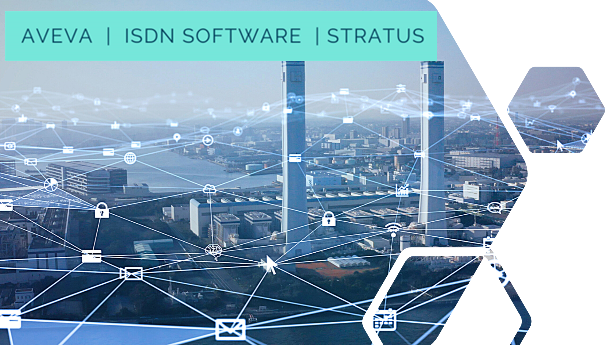
Industrial Innovation Challenge Competition Webinar Presentation 1

Slide 3
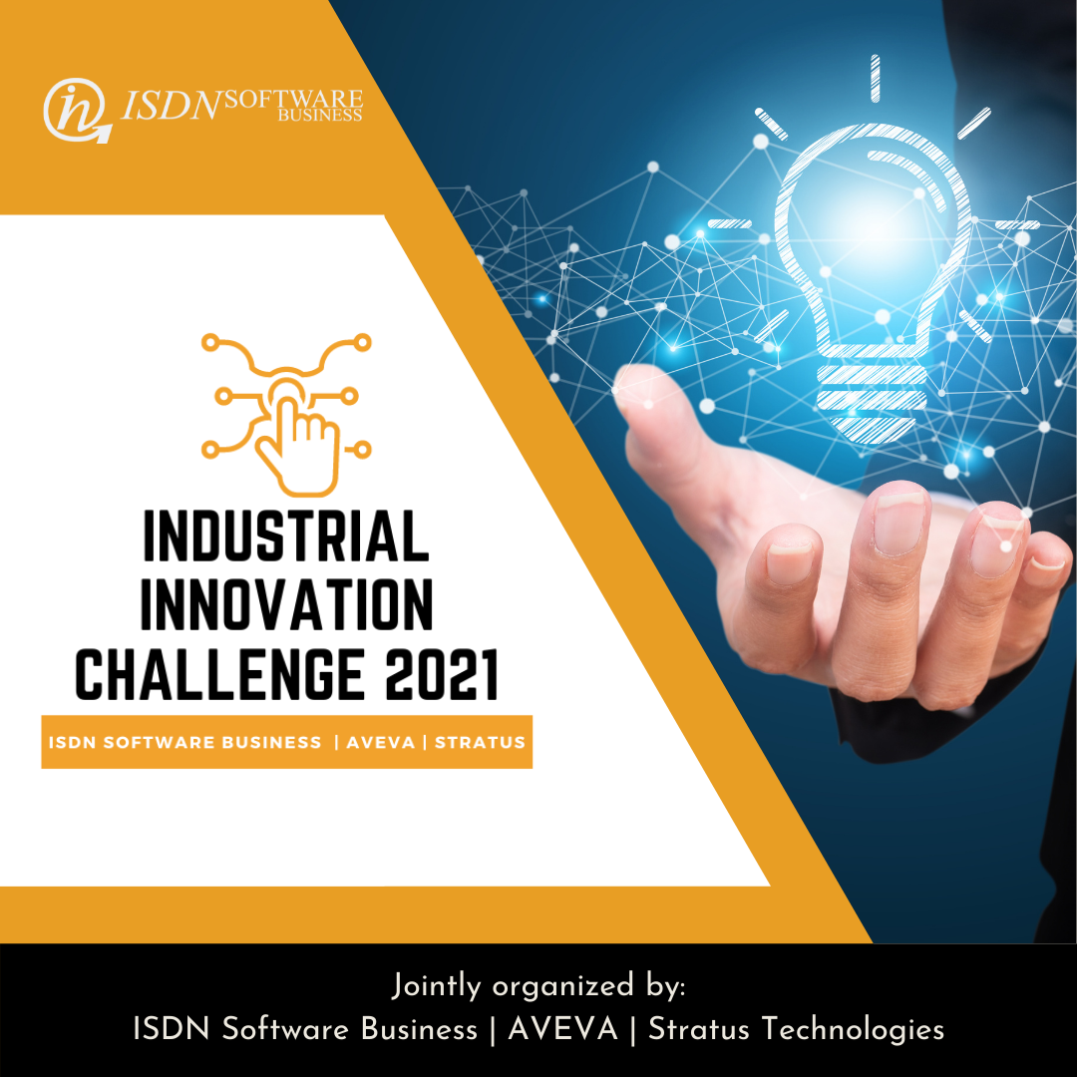
ISDN Industrial Innovation Challenge 2021
The Industrial Innovation Challenge 2021 seeks to get participants to apply their process design skills to solve real-world design problems. A unique opportunity to develop that experience while being mentored and supported through the entire competition by expert leaders from ISDN Software Business, AVEVA and Stratus Technologies

Slide 5
System Platform for Process Information Management and Unify Operation

Slide 6
System Platform Helps to Drive Digital Transformation
DELIVER “KNOWLEDGE” AND “WI﻿SDOM”
Leveraging digitization to improve business performance
Delivers values to the people, process and assets of your business

Slide 7
System Platform as an Enablers for Digitalization Three levels of values proposition
Digitized Process
Process/Operation Management
Cloud Integration
Edge Functionality
Operation Integration Servers
OPC UA Server/Client
OPC DA Server/Client
Web Services (HTTPS)
MQTT (MQTTS)
PLC/Controllers
TCP/IP Secure
Security and Data
TLS1.2
JSON
XMLs
Visualization
HMI/Supervisory
Digital Asset Management
Mobile Access
Process Historian
OEE
Process Management
Information Management and Dashboard
Asset Performance
Workflow
MES
etc
Actionable information and Insights
Data Abnormally
Asset Utilization and Efficiencies
Machine Learning
Artificial Intelligence
Business Intelligence Gateway
Get Access to Your Data
Manage Changes
Drive Operational Performance

Slide 8
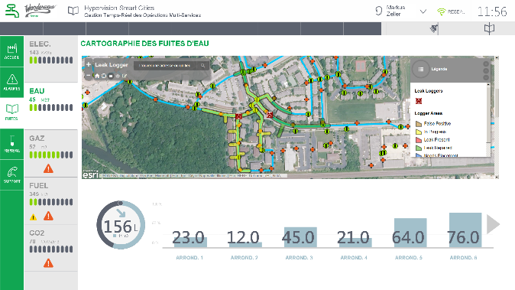
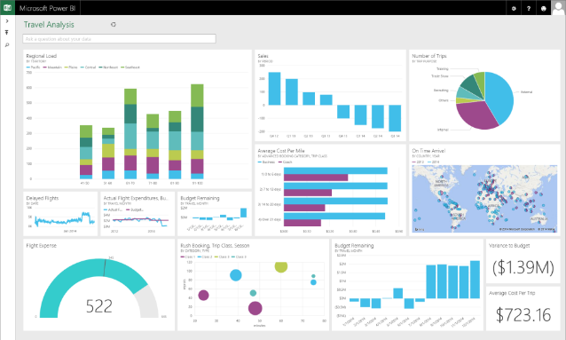
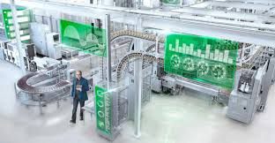
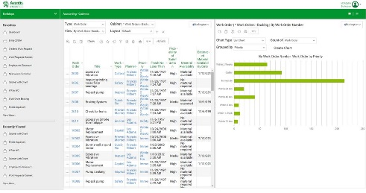
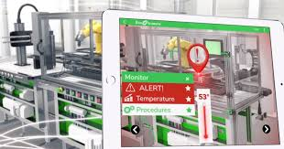
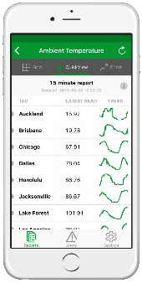
How AVEVA System Platform offer values in Customer Digital Transformation Journey
REAL-OPERATIONS
MANAGEMENT DASHBOARD
Process Dashboard
IOT Data
Instructional Graphics
Asset Information
Improve Operation Efficiencies with Enriched User Experience
Core Platform
Managed Services (SaaS/Cloud)
Functional Evolution
Predictive Analytics
Augmented Reality
Machine Learning
Big Data Analysis
Enterprise Information Management
Operation Management Applications
(Integrated Command Center, MES, Digital Asset Visualization, Unified Operation Centre, Business Workflow, Operation Dashboard etc)
Standardize Best Practices
Points Solutions or Edge Device Applications
(Machine Level HMI, Supervisory Control, Historian, Unify Process Integration, Device Connectivity, Edge Intelligence etc)
Digitize current process

Slide 9
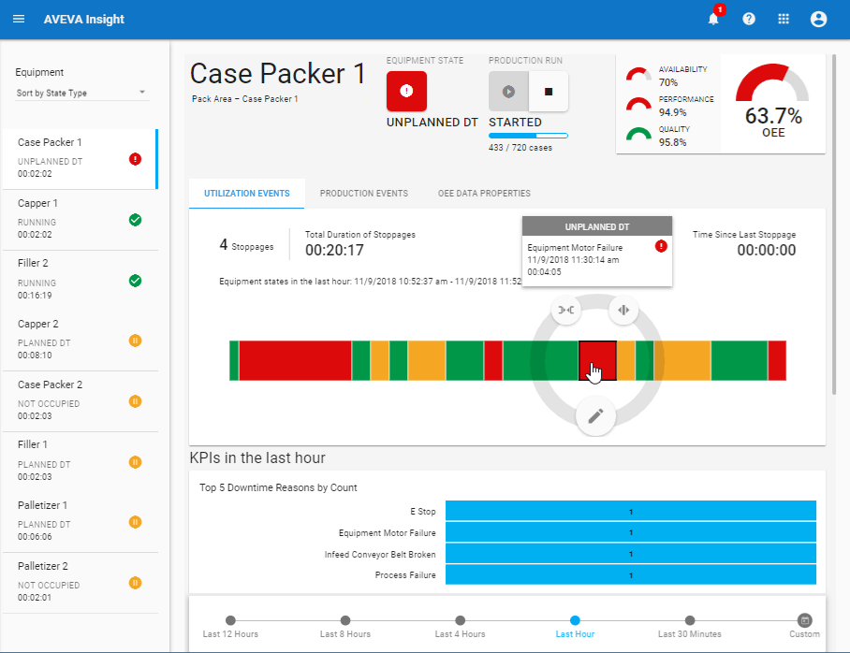
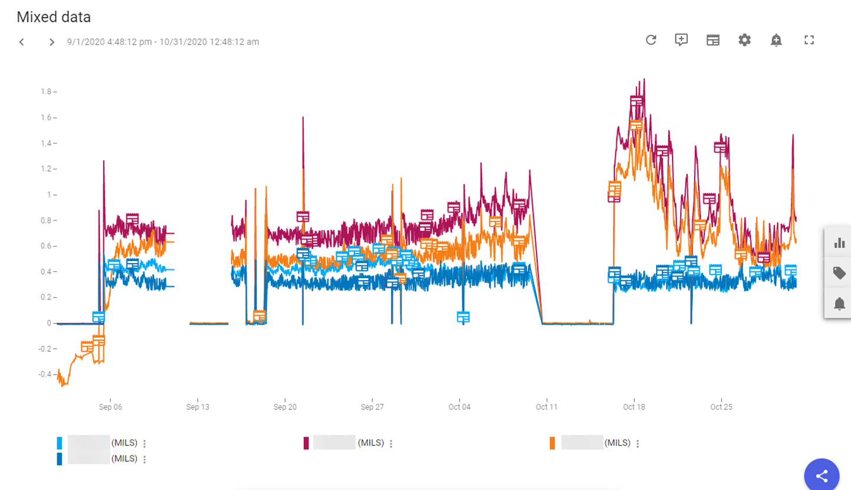
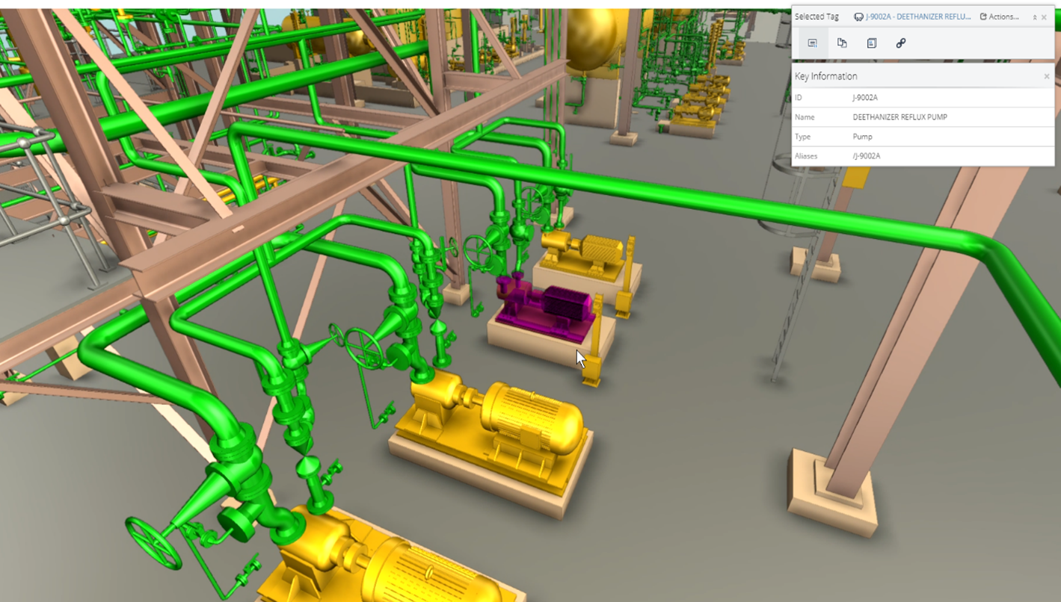
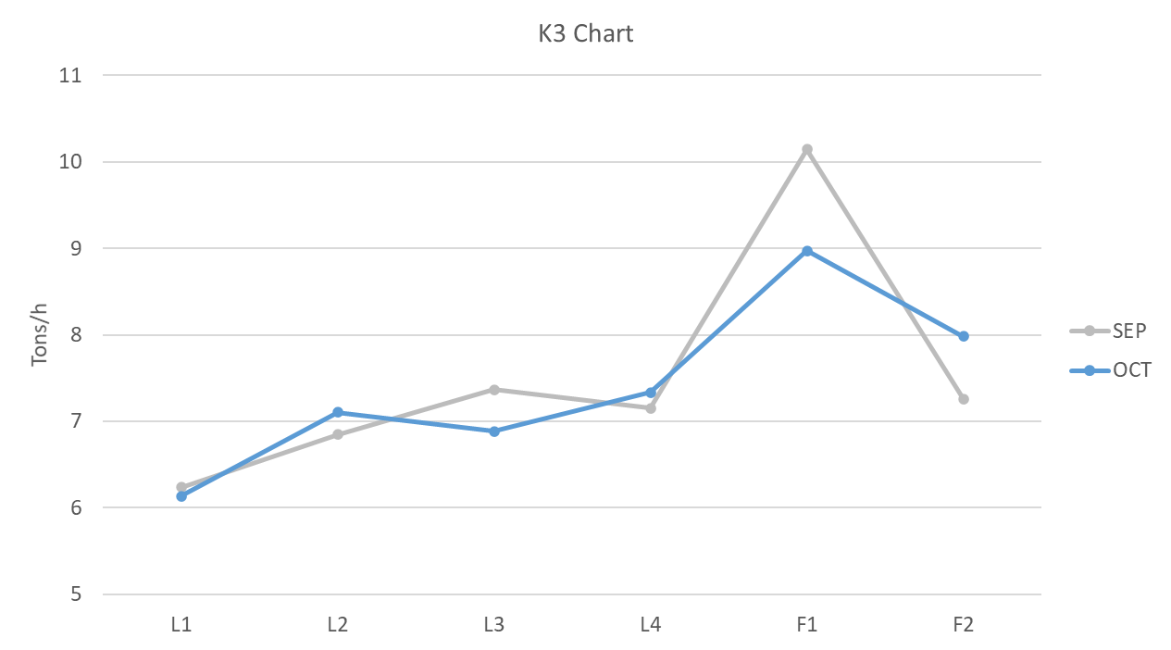
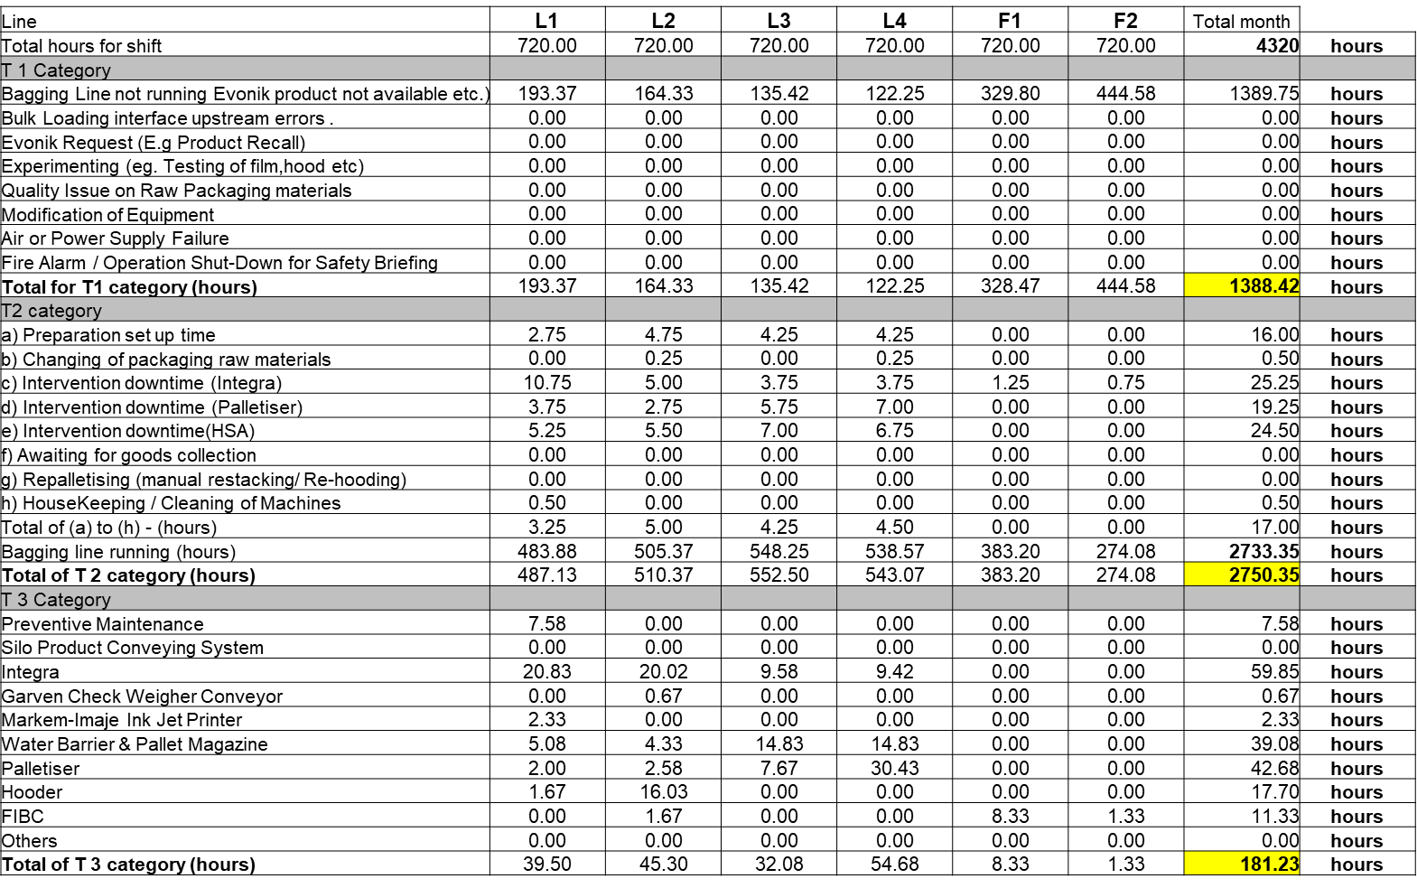
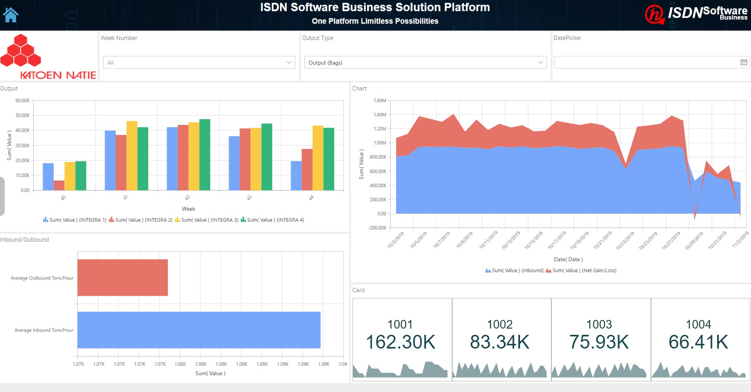
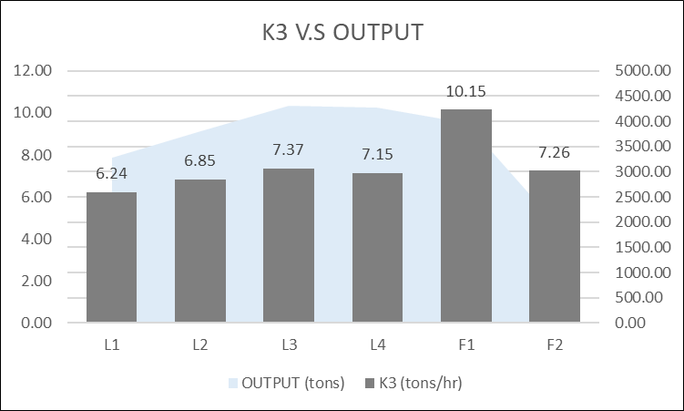
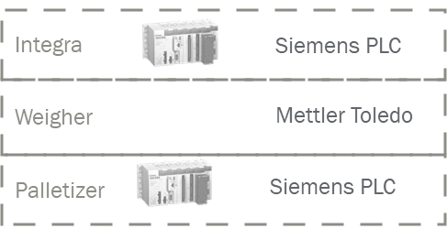
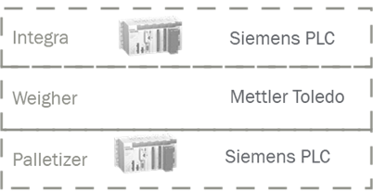
Applying System Platform for Process Information Management
Process System
Process Dashboard
Line Operations
Reports
AVEVA InSight Cloud Managed Services
(Data Abnormally, Actionable InSight, Asset Performance etc)
System Platform
AVEVA Visualization Display and Reporting
(InTouch Process Visualization, OMI Unify Display, Operation Report, Historian Client, Web Client)
Data, Alarms, Events
AVEVA Plant Data Model Framework
(Data Collection, Data Acquisition, Line Model, Historian, Notifications, Alarms, Events, Analysis, Performance Measurement)
History
Batch
MOM
CM
APM
Energy
Other
Communication
Gateway
Communication
Gateway

Slide 10
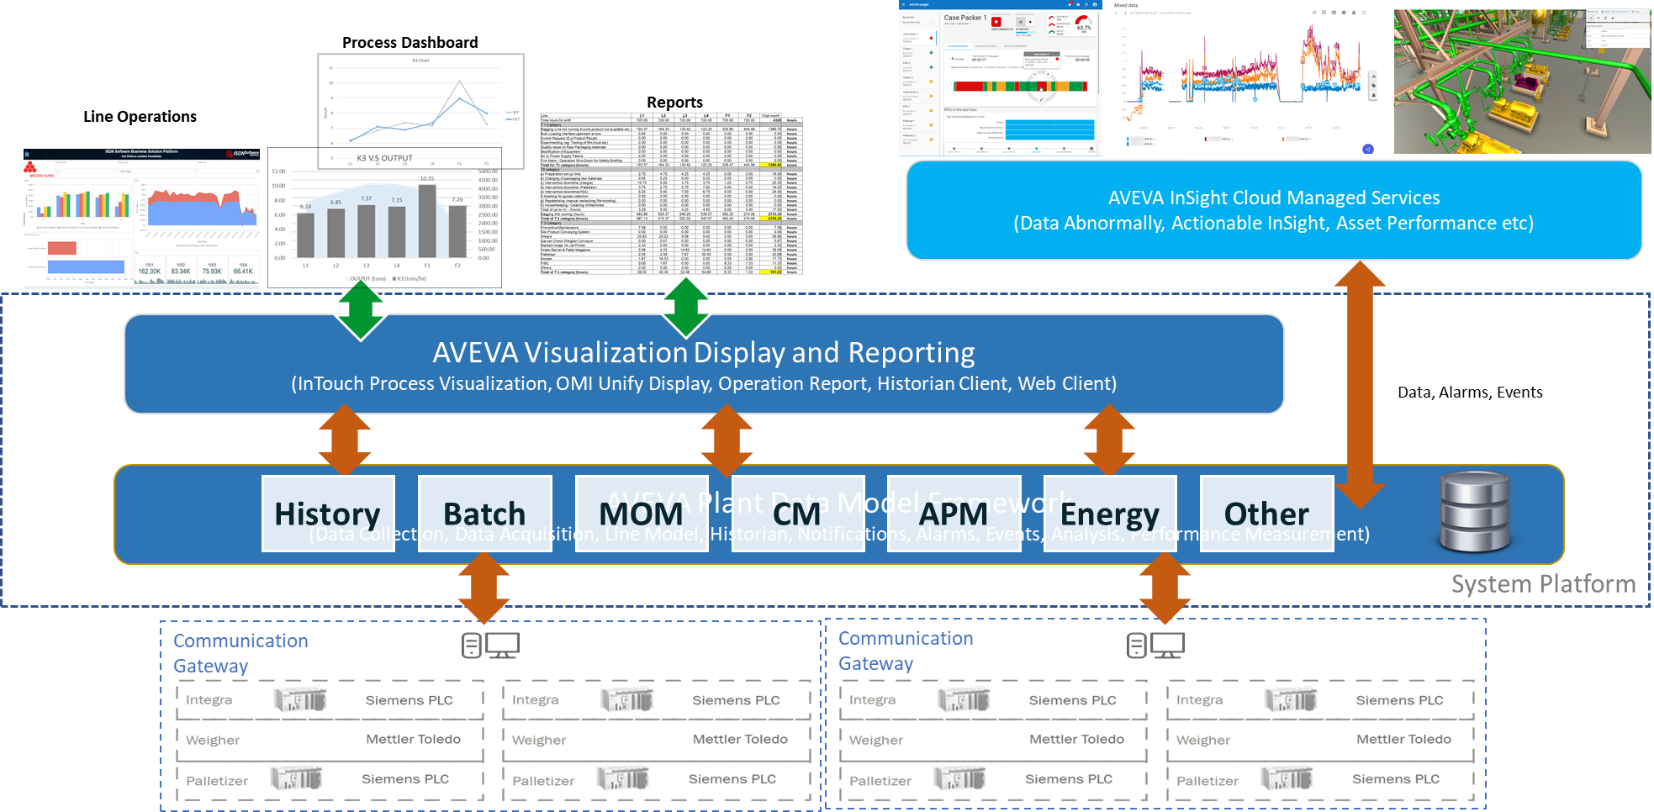
P&I
diagrams
Camera
Weather/ Lightning
GeoSpatial
(Maps)
SCADA/HMI
Analytics/
Reports
Spreadsheets
Documents
3D model
Notes:
Key Elements in Solutions:
Visualization of Information with powerful visual insight
Define and Manage Asset Data
Organizing and take control of process
Overall Goals and objectives:
Asset driven operation with Unique, Context Driven to asset operation in order to execute work more safely and efficiently
Connecting People, Process and Assets

Slide 11
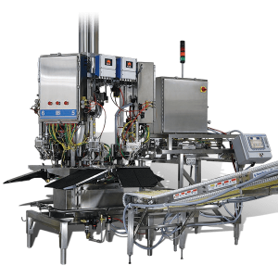
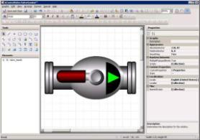
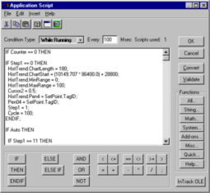
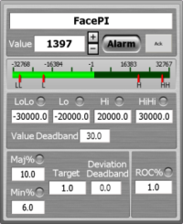
Operations Management Interface
More than HMI
Machine vendor’s digital platform
Logistics & fleet management
Plant Engineering
OMI Operational facets
Physical Asset
Digital asset
System Platform – asset facets
Inputs/Outputs
Alarms & Events
Security
Historical Data
Maintenance
Inputs/Outputs
Metrics/KPIs
Logic/Scripting
Graphics/Faceplates
Operations
Energy
ERP, EAM, LIMS
Planning, scheduling, logbooks
Collaboration, unified communications
Notes:
OMI provides the main user interfaces
Next Gen visualization platform from Wonderware to build
Provide a unified visualization environment to deliver powerful visual insight
To provide operators with Unique, context driven, insights to their process and asset design while minimize time to access the required information from other appliciatons
Connecting People, Process and Assets

Slide 13
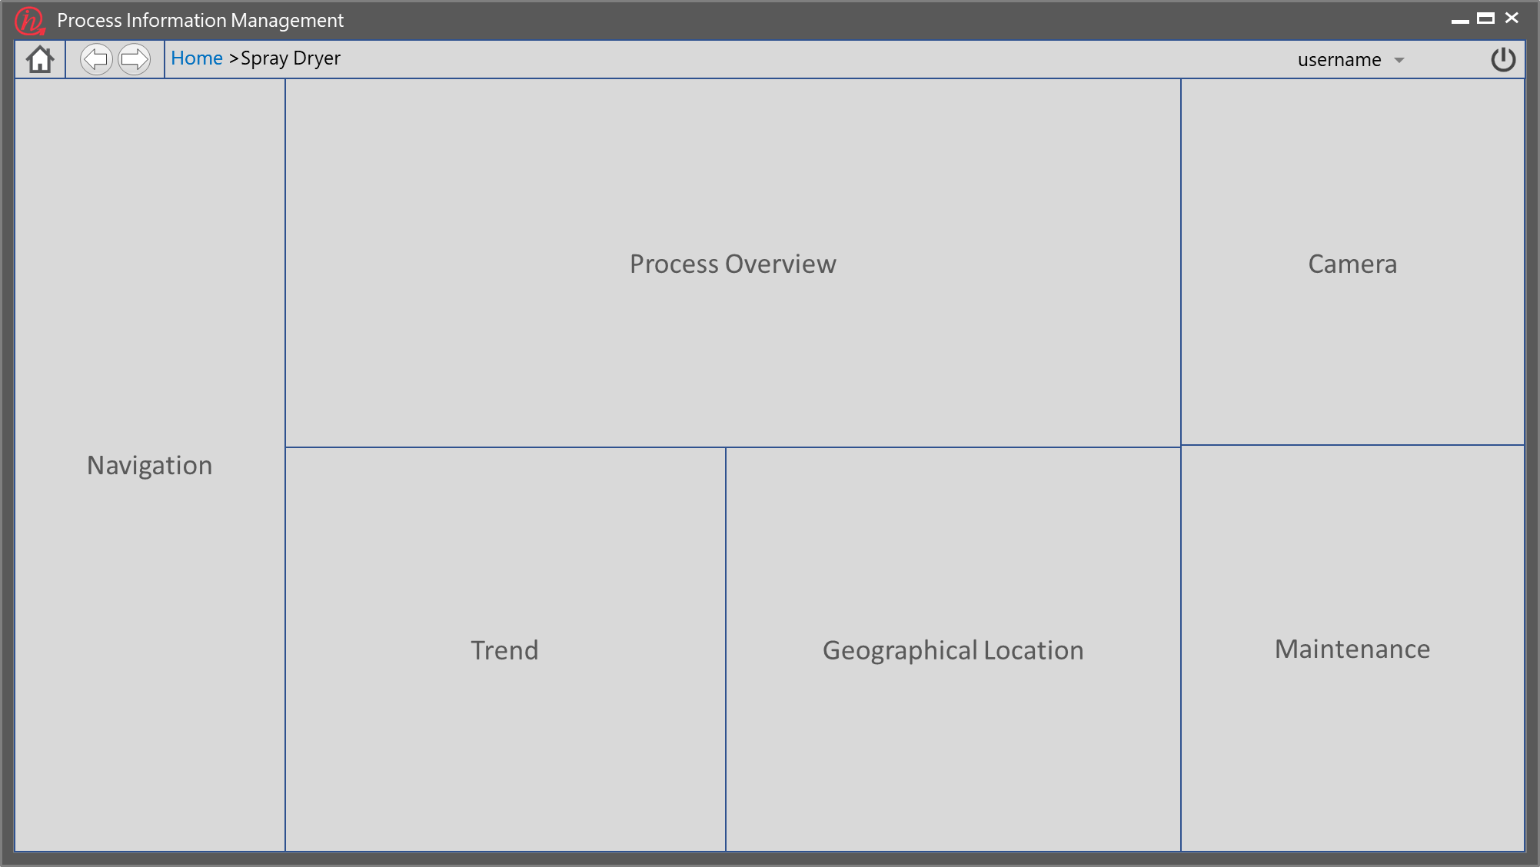
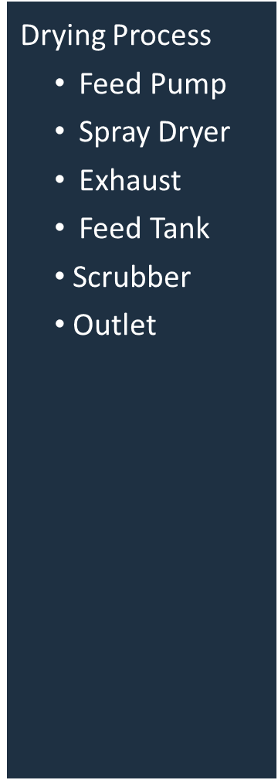
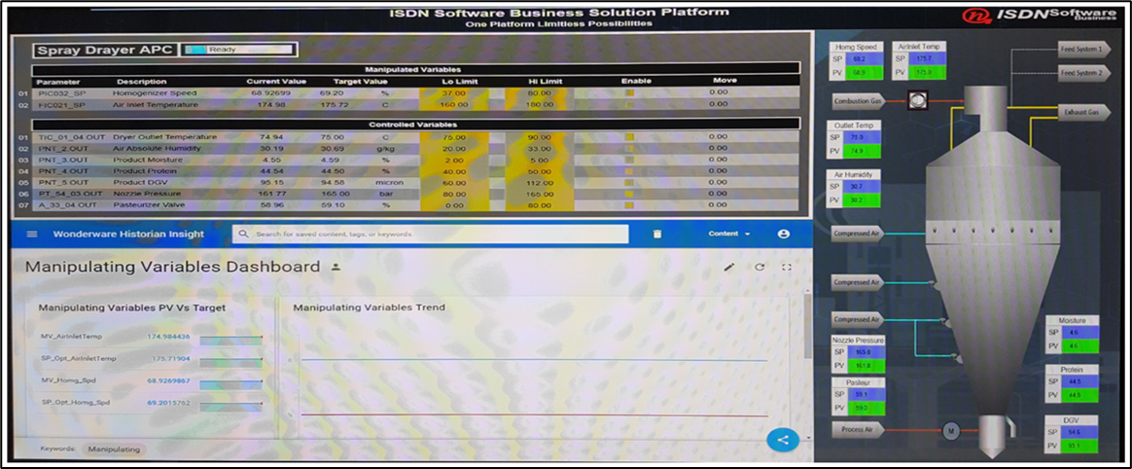
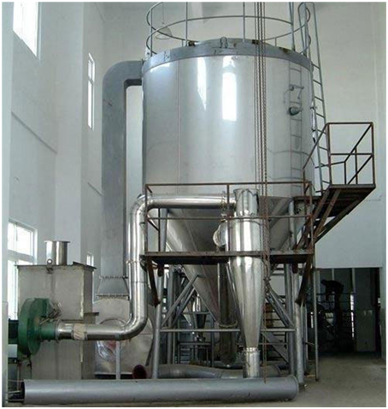
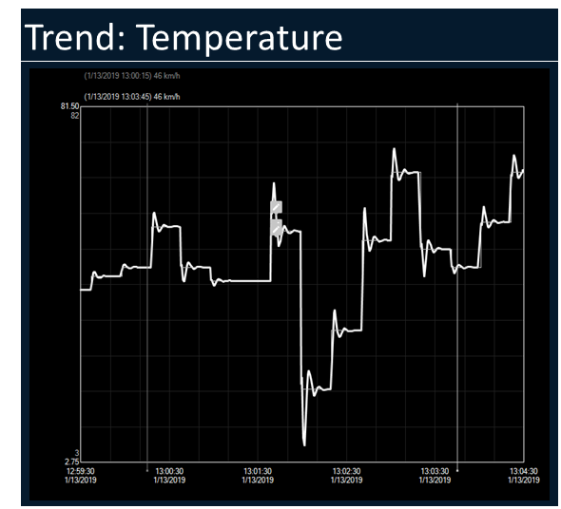
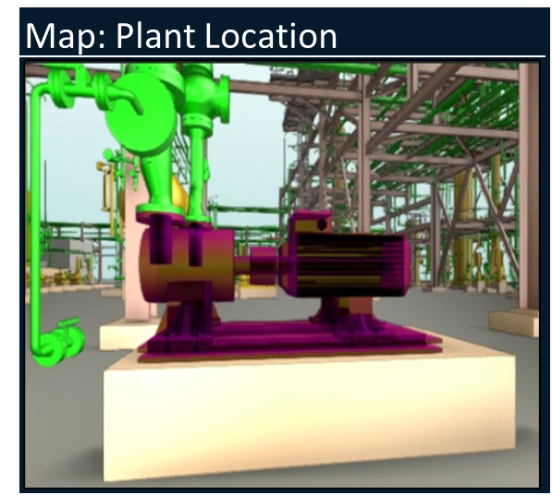
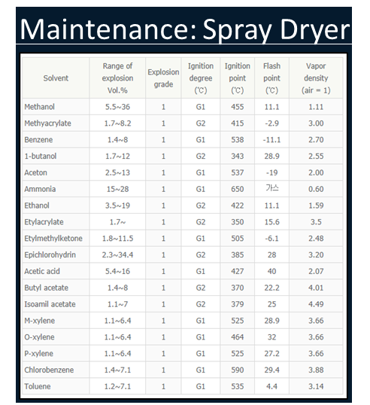
Notes:
Sample screen showing how the contextualize information can be displayed and organize on a single pane for operation efficiencies:
External information building around the asset information: Map, Camera, Work Order etc
Smart Navigation where the information will be updated when the user navigate to other asset
More information can be display if the application is designed with multi-monitors

Slide 14
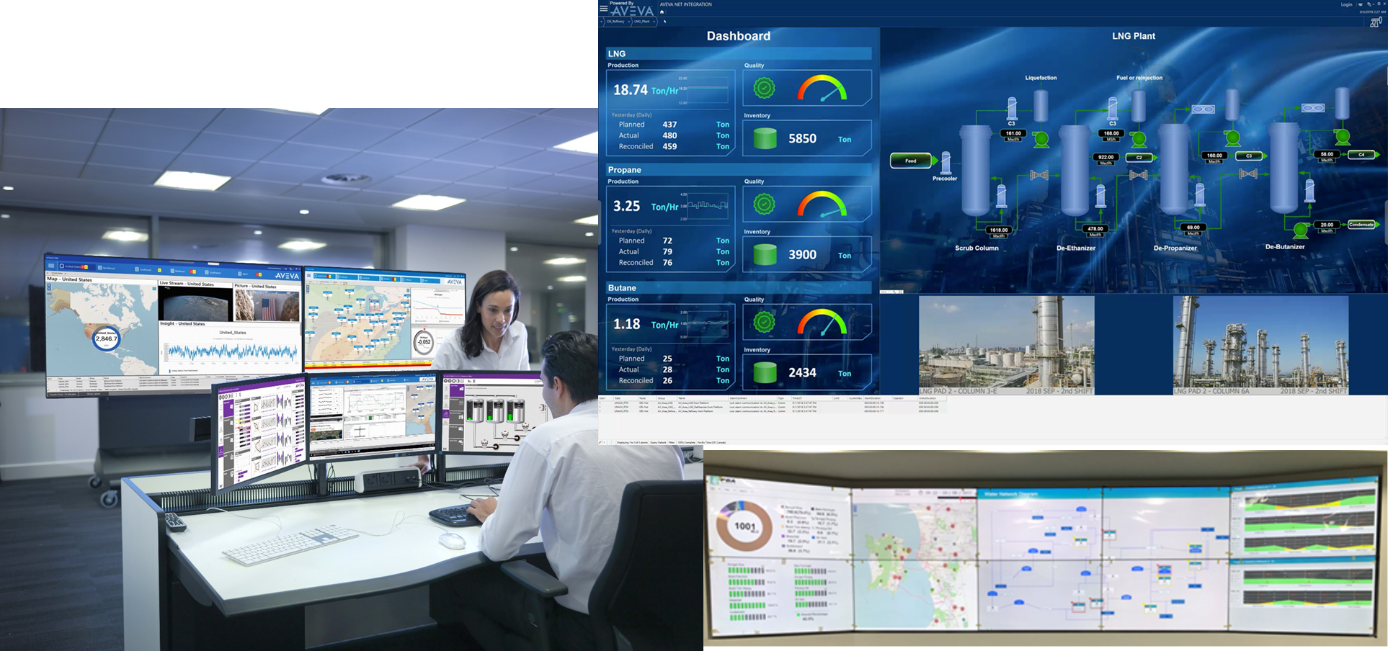
Intrinsic Multi Monitors Support
Linking and organizing information
Notes:
In a control room setup, OMI supports mutli-monitors setup where difference levels of information can be display on difference monitors to provide unified operation:
Plant overview
Process overview
Equipment information
Faceplatform control
Other auxiliary information such as CCTV, KPI etc
All the information again is corrected with the selected process, asset or a single equipment

Slide 15
IT and OT Convergence Platform
Demo Video

Slide 16
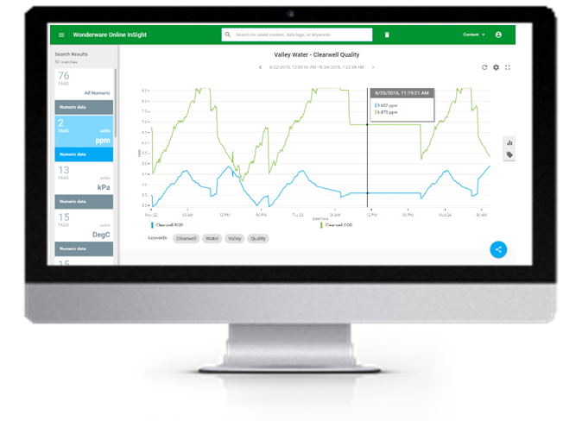
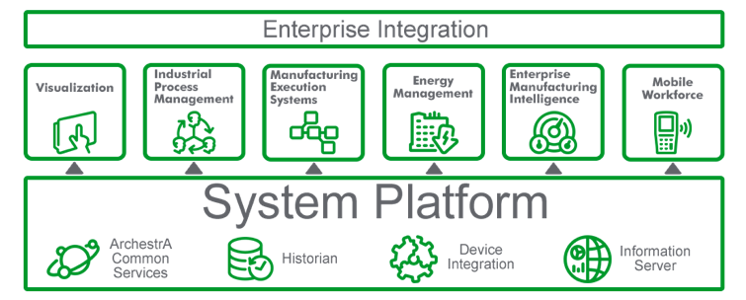
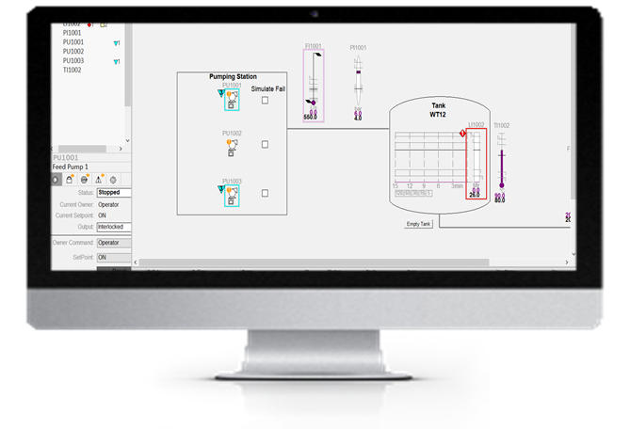
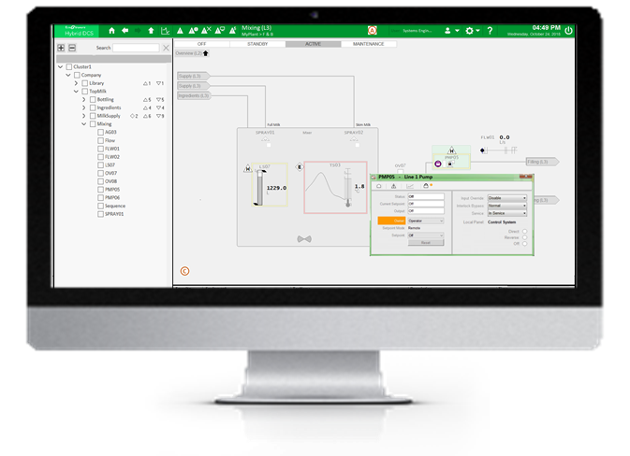
System Platform Functionalities
Operation Management Enabling Platform
Operator Management Interface (OMI)
Situation Awareness HMI Design
Intrinsic TLS Encryption/Certificate Management
Historian
Process Playback
Alarm Management
Build in Diagnostic
Process Recipe Management
APC
Incidents Management
Notes:
Key coverages for Intelligence SCADA using Wonderware System Platform

Slide 17
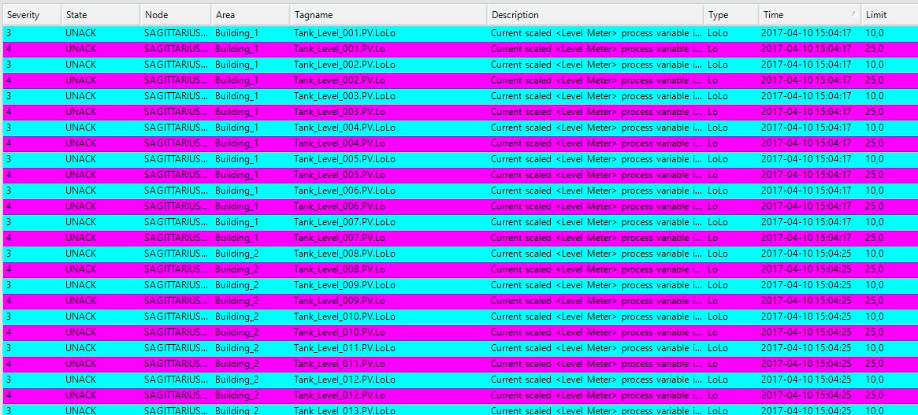
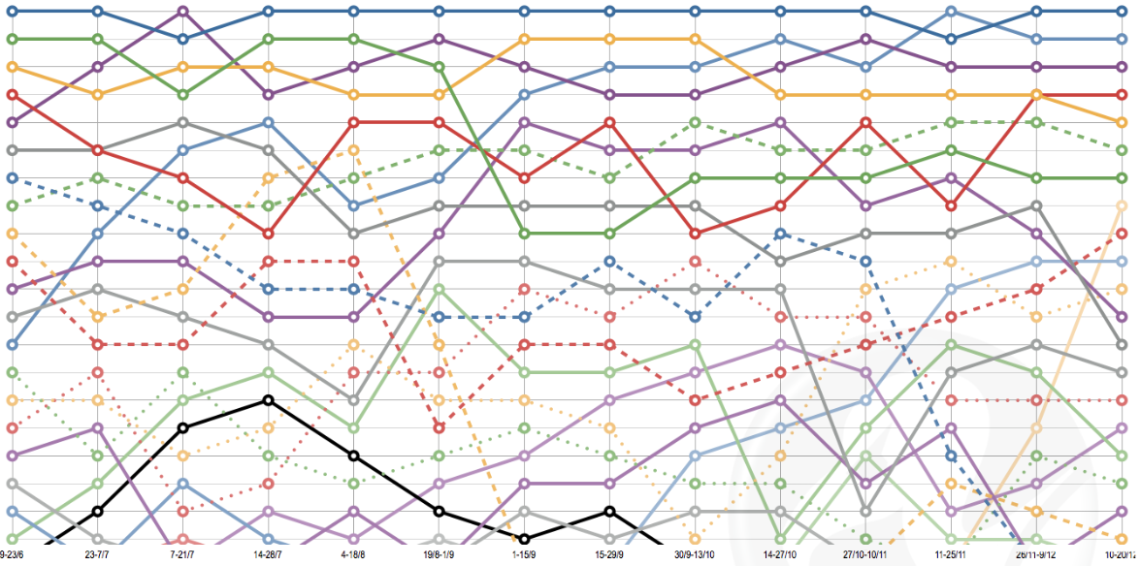
Transforming from Traditional Tag Based…
Tag: Tank_Level_001.PV
Time: 2019-04-24 15:39:17.424
Metadata: Where, who, doing what, …???
Buffer data
Find data, read data
Transfer data, filter, contextualize

Slide 18
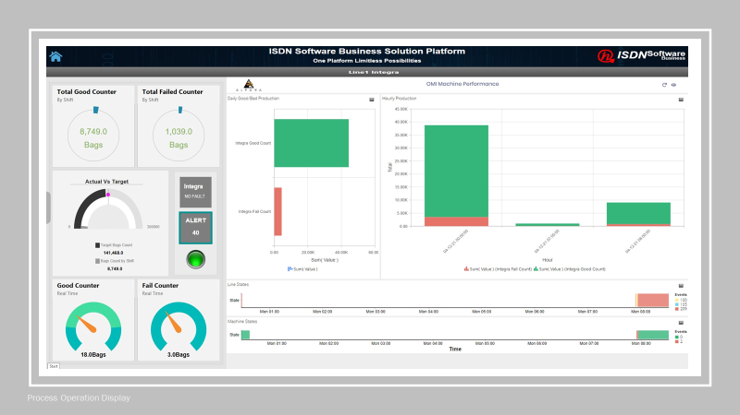
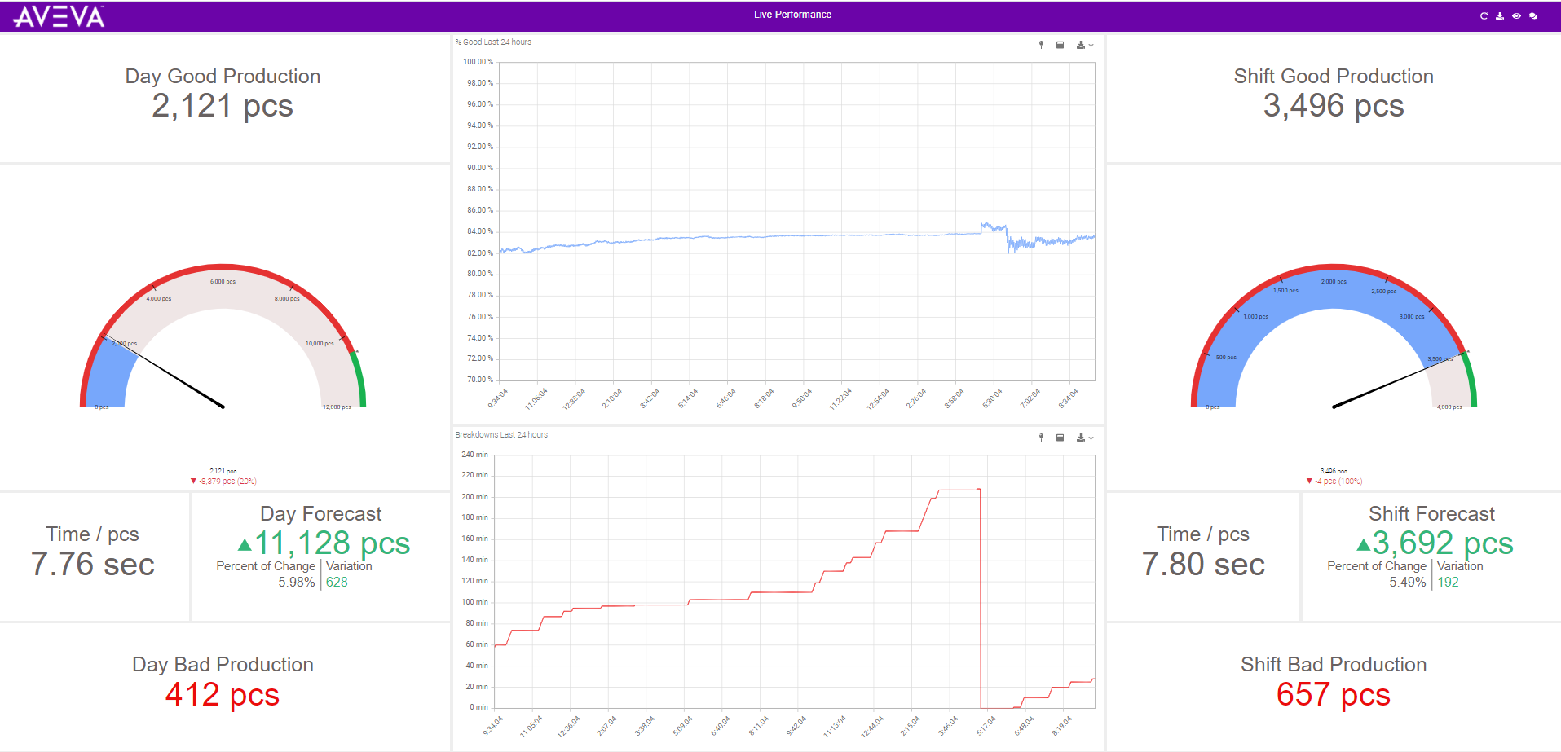
.. To Contextually Driven Content
And playback of historical scenarios

Slide 19
Historian Playback
Demo Video

Slide 20
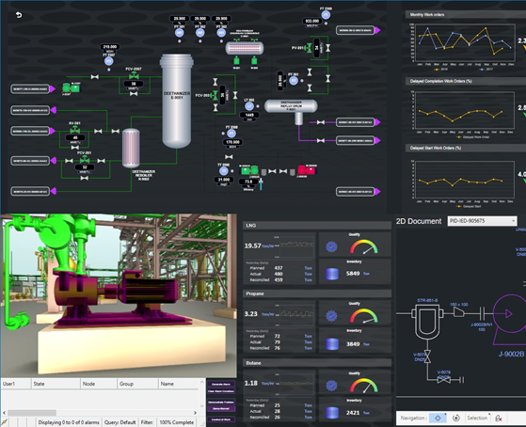
Unified Operation Centre
The UOC solution is an example configuration of using a suite of AVEVA products to create a control room display that integrates asset performance with predictive maintenance, design data and much more.
Unified Operations Centre empowers the operation with a centralized view to help make informed decisions, making end-to-end operational visibility across facilities and helps to improve safety, operational efficiency, and ultimately the profit margins of business.

Slide 21
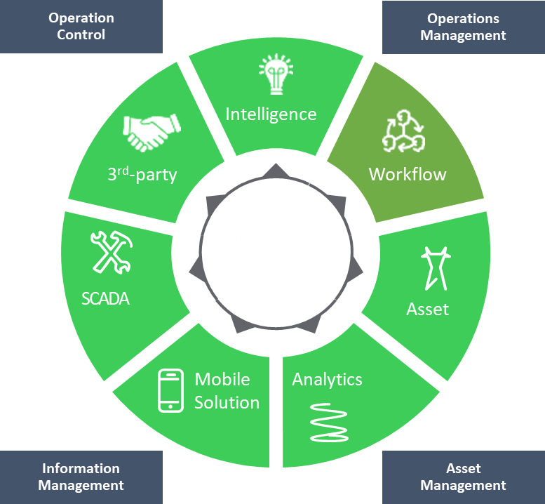
Functional Capabilities : UOC
Central Command & Control : Centralization of operations and resources Management
Operational efficiency : Enhance the capabilities of integrated solutions/track through platform resources like GIS, Workflow, Event Management, Asset Maintenance, collaboration, Business Intelligence etc
Response time : Improve response time to all types of operation events and alarms etc
Availability : Improve performance of critical assets and reduction of maintenance cost
Collaboration : Facilitate the interagency/departmental collaborations and information sharing
Planning : Optimize planning and respective process through big data analytics
Visibility : Improve the operational visibility through dashboards
Decision Support : Platform become the decision support system

Slide 22
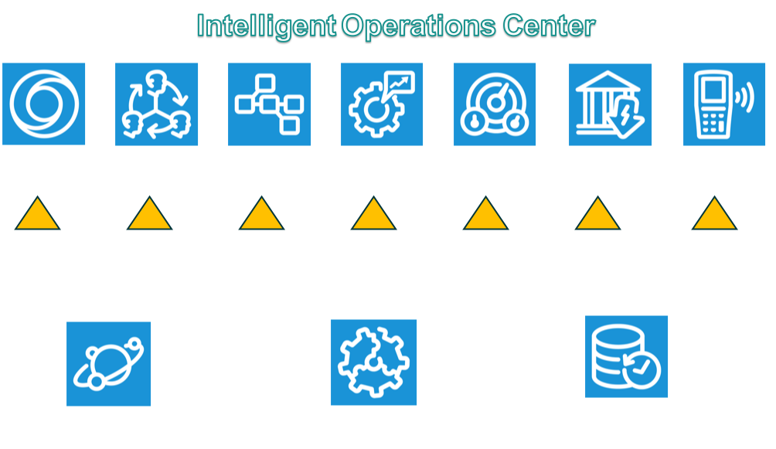
In Summary: Transforming the way we work
Operational performance metrics monitored in real-time
“Out-of-the-box” Integrated performance management (reports, metrics, analysis, and planning tools in industry specific)
Enterprise Integration: Leverage existing IT and OT infrastructure investments
Multi-site performance visibility at the operations level
Delivers consistent view of the business across functional groups
Hierarchies of linked objectives, KPIs, targets, plans and alerts

Slide 23
The right infrastructure to power your transformation
Xyvier Goh Junxian

Slide 24
Increasing Demand for High Availability
Limited access, bandwidth and skills
Notes:
The problem is that more advanced computing is needed at these remote, industrial locations.
[click] – At places that are hard to get to, with limited access. Places that lack bandwidth or have limited resources, if there are any people there at all.
Who’s going to make sure that the computers at these remote edge locations continue to function as intended? Who’s going to operate them, update them, and fix them if they break?

Slide 25
Today’s Reality
Primary SCADA server
Backup SCADA server
“When applications stop working we don’t even
know until other issues arise”
Historian server
Thick clients
“IT does a great job of
scheduling planned
downtime, but the
bigger issue is
break/fix ”
“Our systems are so old
and fragile and we dare not
change anything in case
it breaks”
PLC/SCADA
Reactive
Complex
IT “heavy”
Complex redundancy where most critical
Break/fix or constant monitoring
Each system individually managed
Mixed O/S environments with security holes
ICCS isolated to secure plant floor devices
Local workstation required to access information

Slide 26
Stratus is
SIMPLE
PROTECTED
AUTONOMOUS
Notes:
In an ideal world, edge computers would be,
[click] – simple to use [pause]
[click] – easy to protect [pause]
[click] – and operate autonomously. [pause]
To account for the fact that edge locations are often remote, with limited access, and limited resources, including people or skilled IT resources.

Slide 27
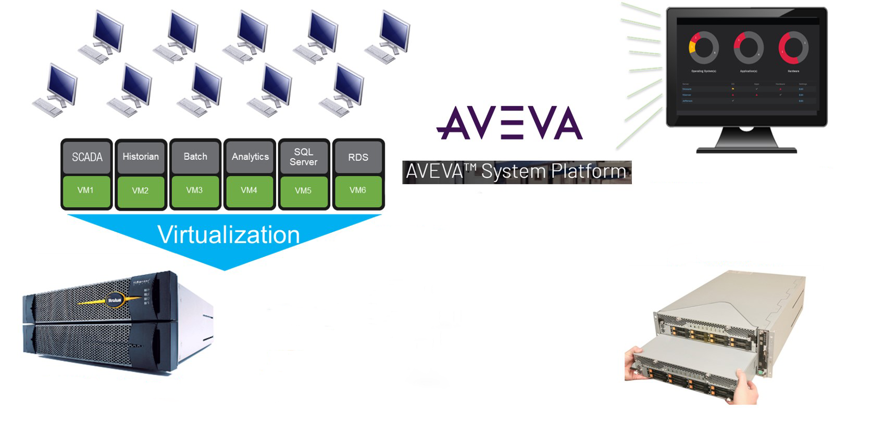
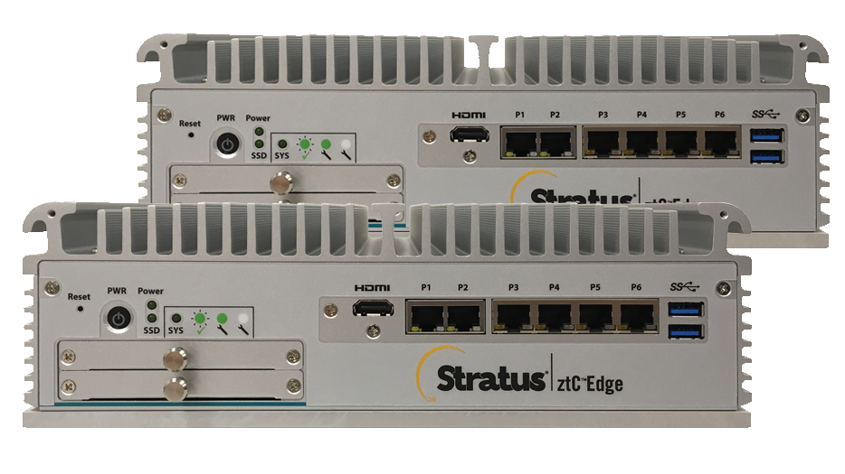
Modern Automation Infrastructure Powered by Stratus
Continuous Health Monitoring
Server Virtualization
Fault Tolerant Computing
Simple to Maintain

Slide 28
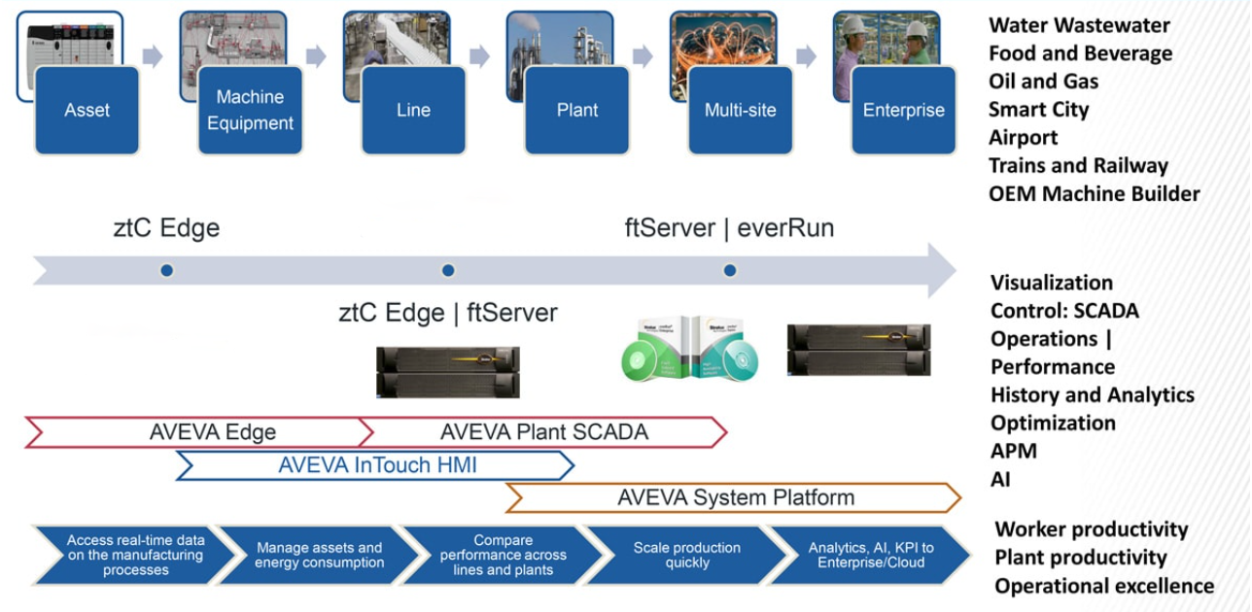
Single Partner from Edge to Enterprise

Slide 29
Thank you
The Need for Availability is growing!

Slide 30
30 July 2021
Web Demo #1: System Platform General Overview

