Slide 1
Warehouse Management System (WMS)

Slide 2
01
Warehouse Management System (WMS)

Slide 3
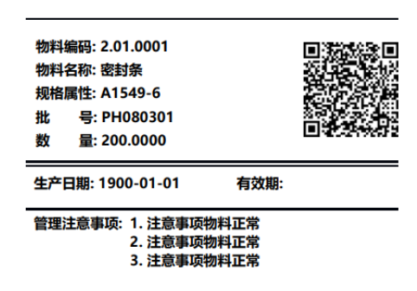
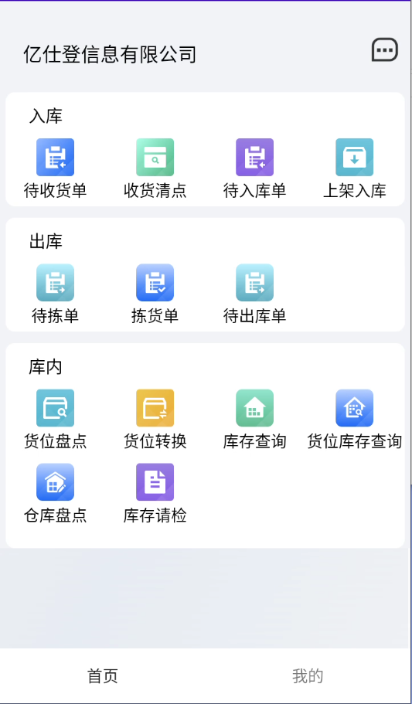
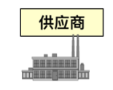
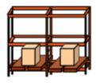
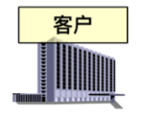
Business Process
Print material labels
Supplier
Receiving and counting
Putting on the shelf and into storage
Inbound
Pending receiving
note
Receiving and counting
Pending warehousing note
Warehousing
Outbound
Pending pick
note
Picking note
Pending delivery
note
Outbound Distribution
picking
In Warehouse
Inventory check by location
Location transfer
Inventory query
Inventory query by location
Warehouse inventory check
Inventory inspection request
Client
take sth. off the shelf and out of storage
Printing of delivery notes
Home
My Account
34

Slide 4
Function
By barcode, label management
Customized shelving strategy, picking strategy, intelligent recommendation of cargo space.
Batch and serial number management
Warehouse material expiration date management, expiration date warning reminder
Pallet and box management
Management by bay area
Manual and intelligent warehouse operations
45

Slide 5
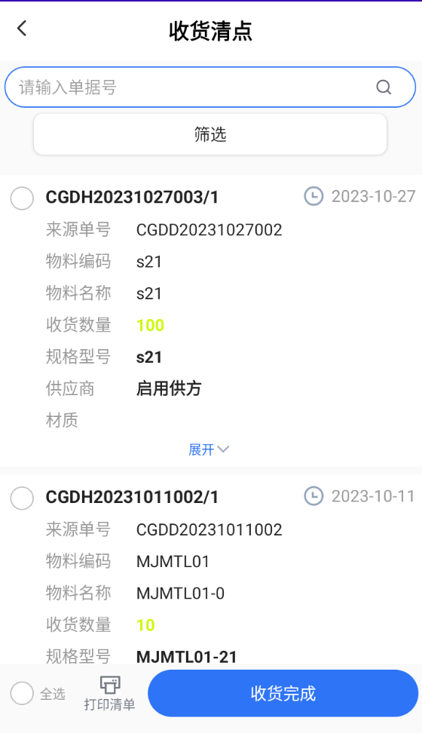
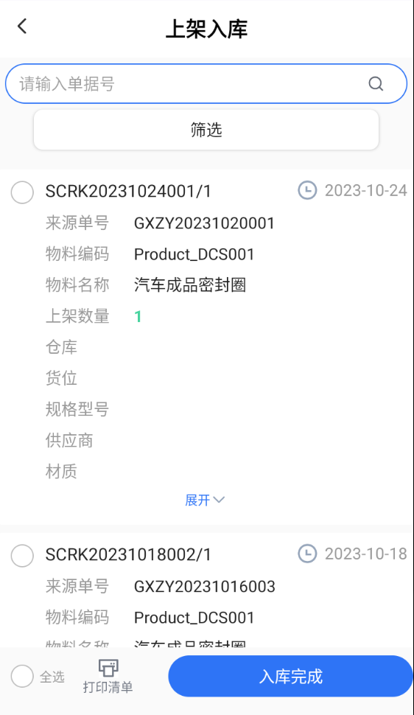
Function
Putting on the shelf and into storage
Receiving and counting Warehouse arrivals, physical counting of arrivals
Label Printing Arrival is complete and material labels are printed
Inventory materials According to the shelving strategy, recommend the appropriate storage space, scanning labels into the warehouse operation.
56

Slide 6
Function
Shelving Strategy
1. The principle of first down, then up
Distinguish by the level of the cargo space, prioritize the recommendation of the lower level of the cargo space that meets the conditions.
2. Quantity close to the principle of cargo space
Prioritize the recommended space availability, the space closest to the number of goods on the shelves.
3. Principle of concentration of similar materials
Identical materials are shelved in the same bays.
67

Slide 7
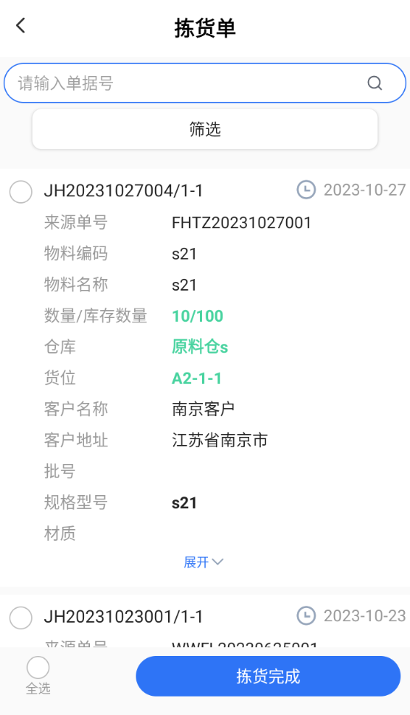
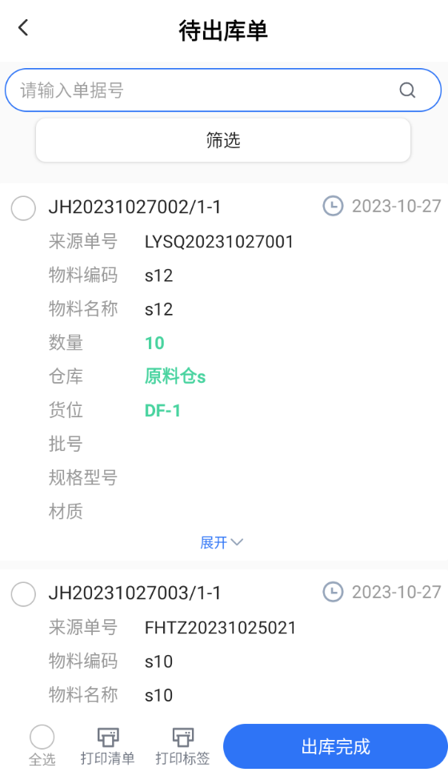
Function
Taking Off The Shelf And Out Of Storage
Picking operation Picks materials for outbound storage according to the picking strategy.
Picking Completion Picking is completed, and the materials picked out of the warehouse are transferred to the area to be shipped.
Material Outbound Picks materials out of the warehouse from the pending shipment area. Prints outbound labels, outbound manifests.
78

Slide 8
Function
Downsizing Strategy
1. The principle of first down, then up
Distinguish by the level of the cargo space, prioritize the recommendation of the lower level of the cargo space that meets the conditions.
2. First-in-first-out principle
First in, first out.
3. Quantity close to the principle of cargo space
The number of picks is close to the number of materials stored in the bay.
4. Principle of Designated Customers
In response to a sales order, a finished product is produced in a lot that cannot be sold to that customer, or can only be sold to that customer. Picking is based on the designated customer principle, and the appropriate lot is picked.
Material.
5. Disregard of the principle of fractional lots
Produce finished packages where there is a fractional number of boxes that are less than a full box. Pick and filter the lot of material.
89

Slide 9
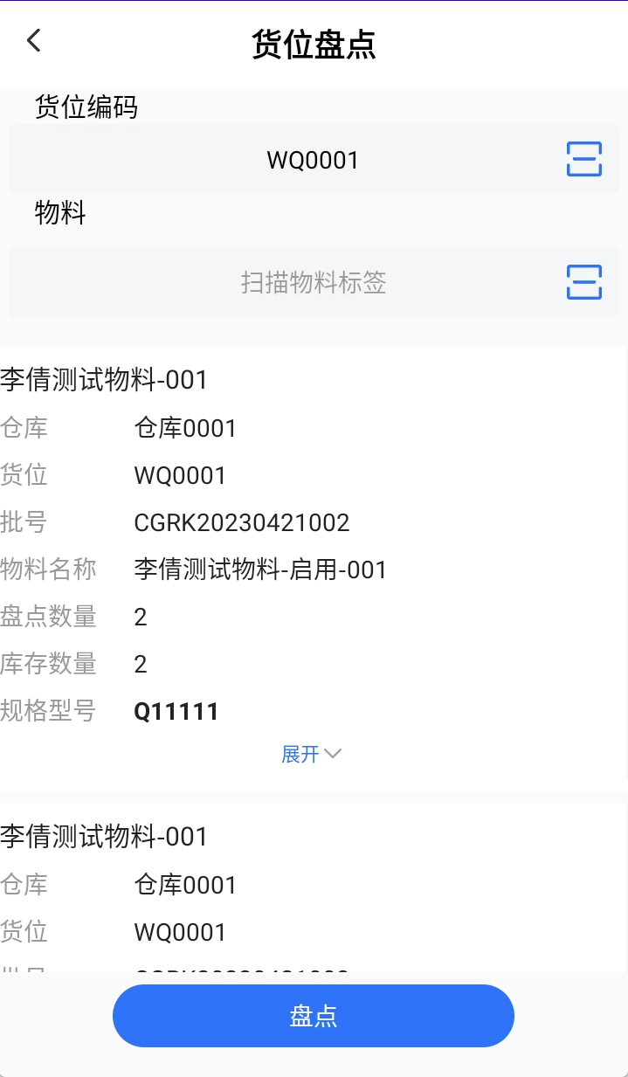
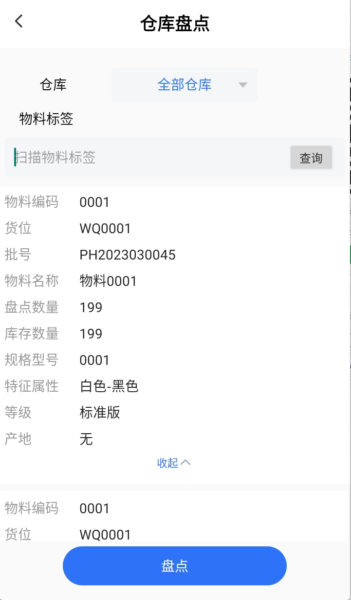
Function
Create An Inventory
Cargo space inventory:
Inventory the materials stored under the stock by dimension of the stock. Inventory is completed and the inventory list is generated.
Warehouse inventory:
Inventory the stock of a material at each storage location under the inventory warehouse.
910

Slide 10
Function
Batch management
Expiry date management
For the expiration date of materials, management by batch dimension. The same batch of materials, the expiration date of the same.
Batch traceability
When the production quality is abnormal, it can be traced through batch traceability to all the affected production batches, raw material suppliers and other information. Batch management is a necessary element to provide information services for traceability.
Material Inventory Management
FIFO of material batches, filtering out material batches by batch dimension.
1011

Slide 11
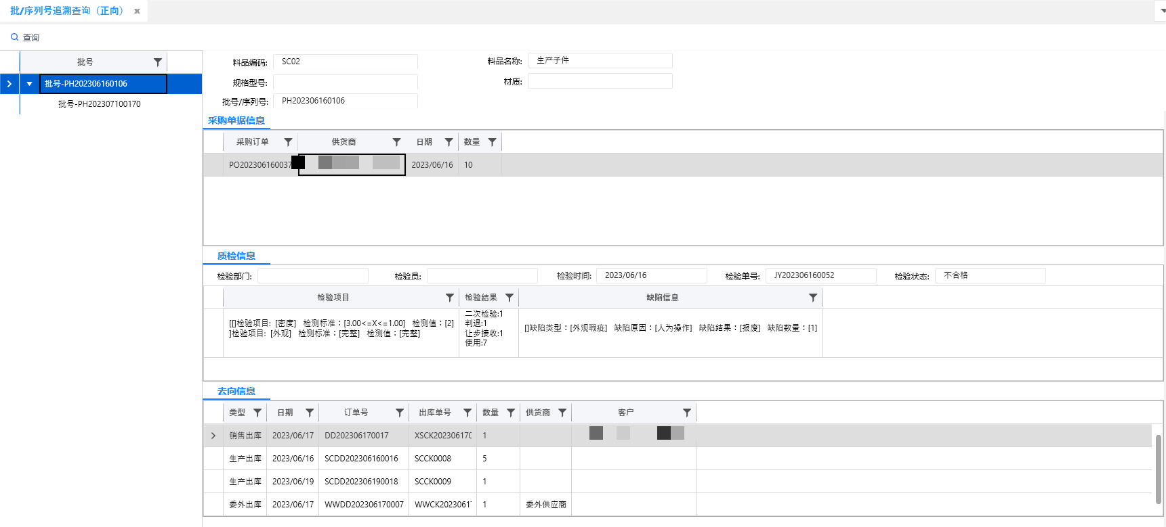
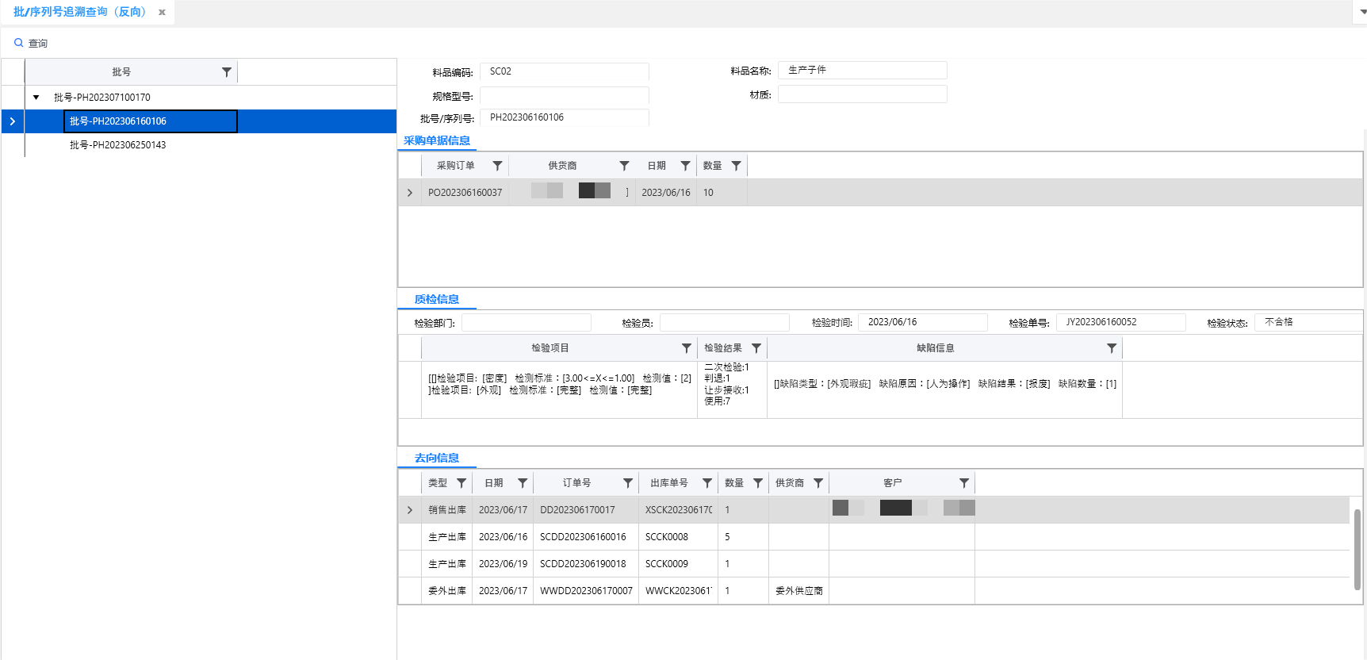
Function
Batch traceability
Supports forward and reverse traceability
Support lot number and serial number traceability
Trace production information of lot number and serial number, procurement information, outsourcing information, quality control information, and destination information content
1112

Slide 12
Reporting Functions
Inventory ageing statement
Pickup logic
Analyze how many quantities of a material are available in stock for each of the set aging periods.
Sort
Then understand how long these materials have been stagnant, the age of that part of the material, may need to be disposed of, so as to improve inventory turnover, control inventory costs.
1213

Slide 13
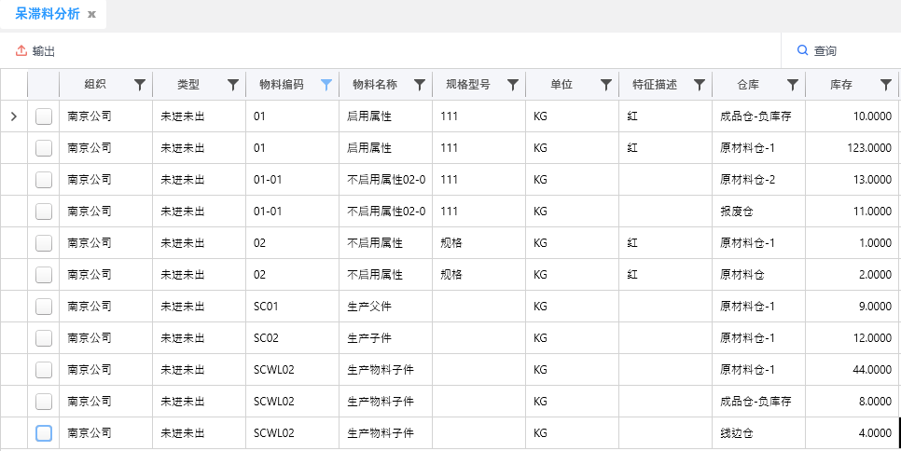
Reporting Functions
Dull material analysis report
Pickup logic
Statistics in a certain time range has not been in stock nor out of stock, or only in stock but not out of stock of materials, and display these materials in the query date of the inventory.
Sort
Avoid backlogs in inventory of obsolete materials and reduce the incoming production, purchasing, etc. of obsolete materials.
1314

Slide 14
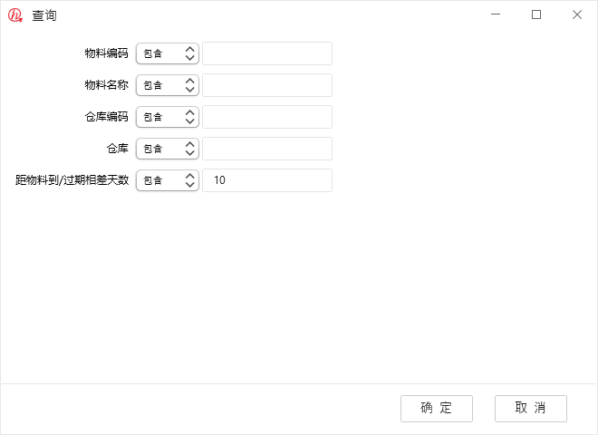
Reporting Functions
Shelf life warning statements
Pickup logic
Customize the number of days to expiration to view the inventory materials that have expired or are about to expire during the period based on the current date and the set number of days to expiration.
Sort
Visualize the expiration date of inventory materials, or have expired, early warning to view the expiration date of the material, do sales or scrap disposal.
1415

Slide 15
Reporting Functions
Inventory turnover statement
Pickup logic
Inventory turnover = Quantity out of stock/[sum (daily inventory)/days]
Turnover days = 365/turnover rate
Sort
It is used to reflect the turnover speed of inventory, which prompts the enterprise to ensure the continuity of production and operation and at the same time, improve the efficiency of the use of funds and enhance the enterprise's short-term solvency.
1516

Slide 16
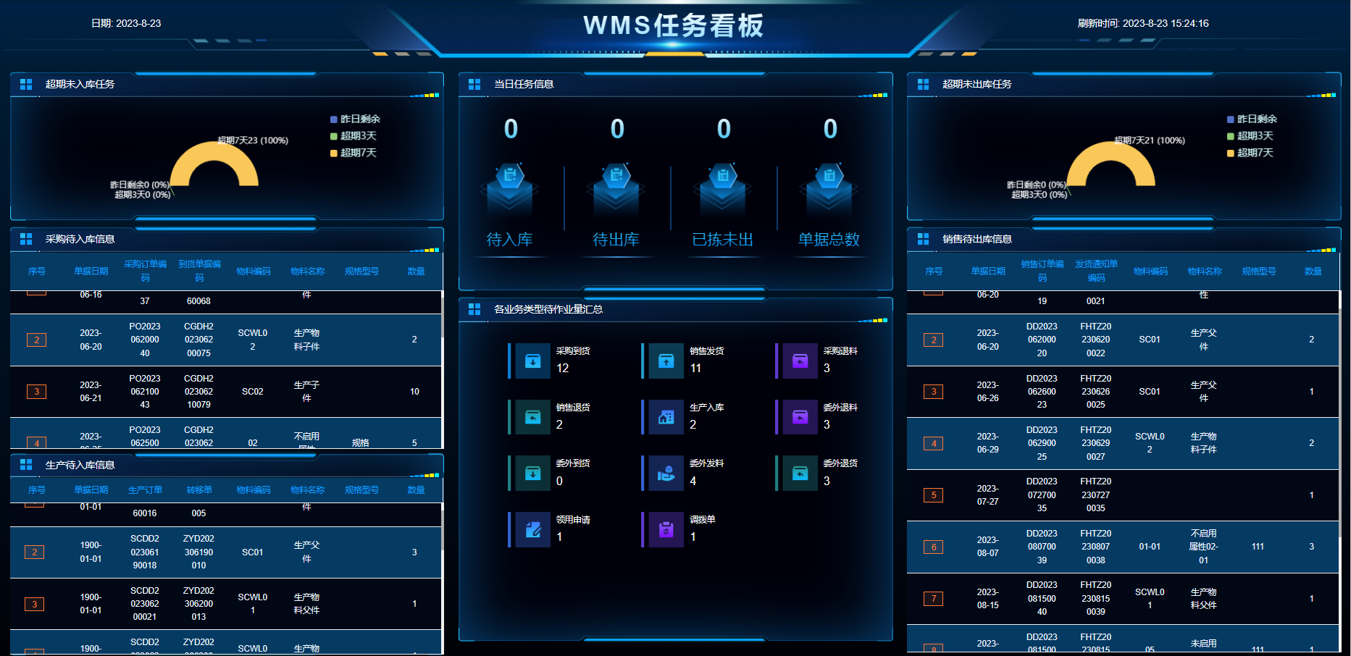
WMS Warehouse Monitoring Screen
WMS Task Kanban
Statistics warehouse day to be operated, has been operated by the documents task
Statistics on overdue tasks
Statistics on overdue tasks
Statistics on the details of documents that have been purchased but not put into stock
Statistical information on the details of documents shipped by sales but not shipped out of the warehouse
Statistics of unworked documents of each business type
1617

Slide 17
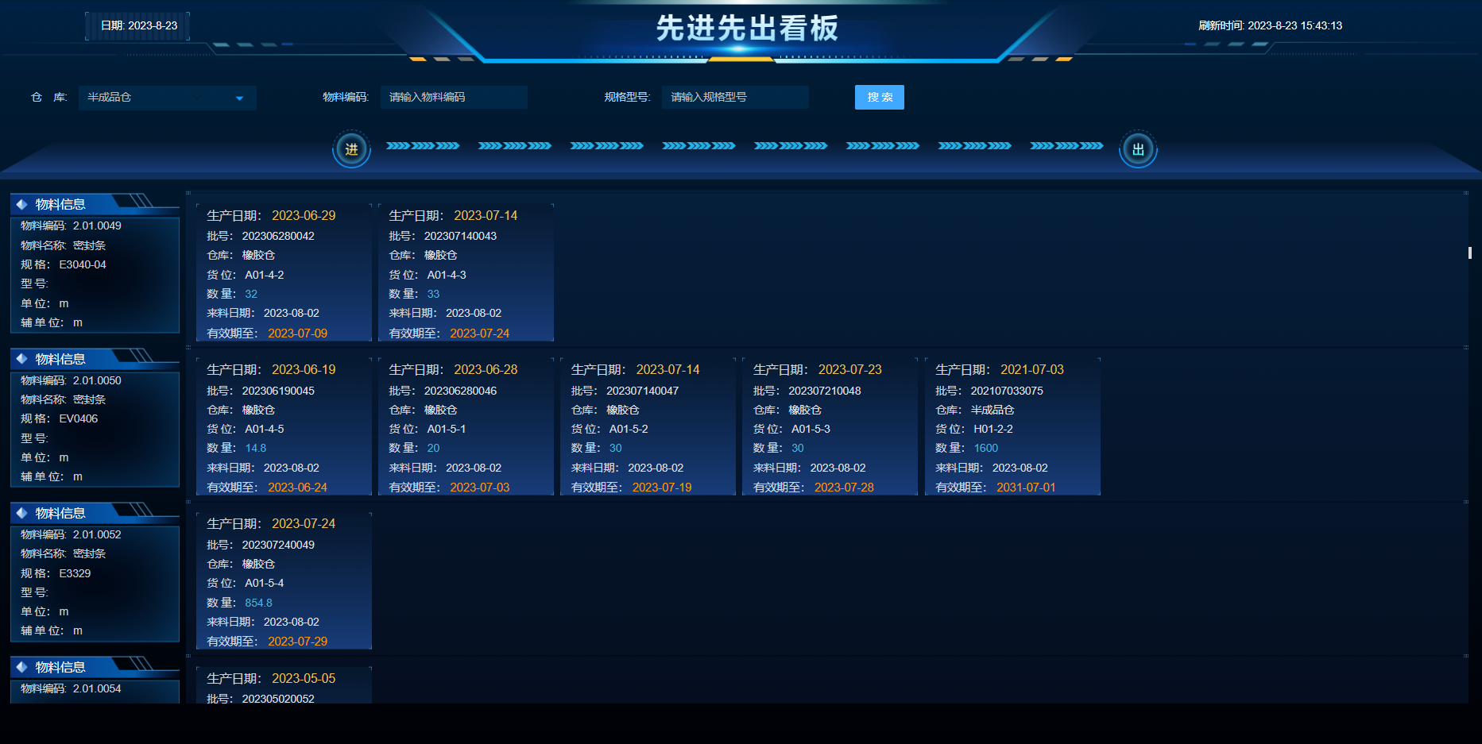
WMS Warehouse Monitoring Screen
FIFO Kanban
List materials in reverse chronological order according to their date of manufacture. Inventory information by lot number, by stock level.
Warehouse picking out of the warehouse, based on the principle of first-in-first-out, preferred.Inventory materials that are shipped out first and produced first.
1718

Slide 18
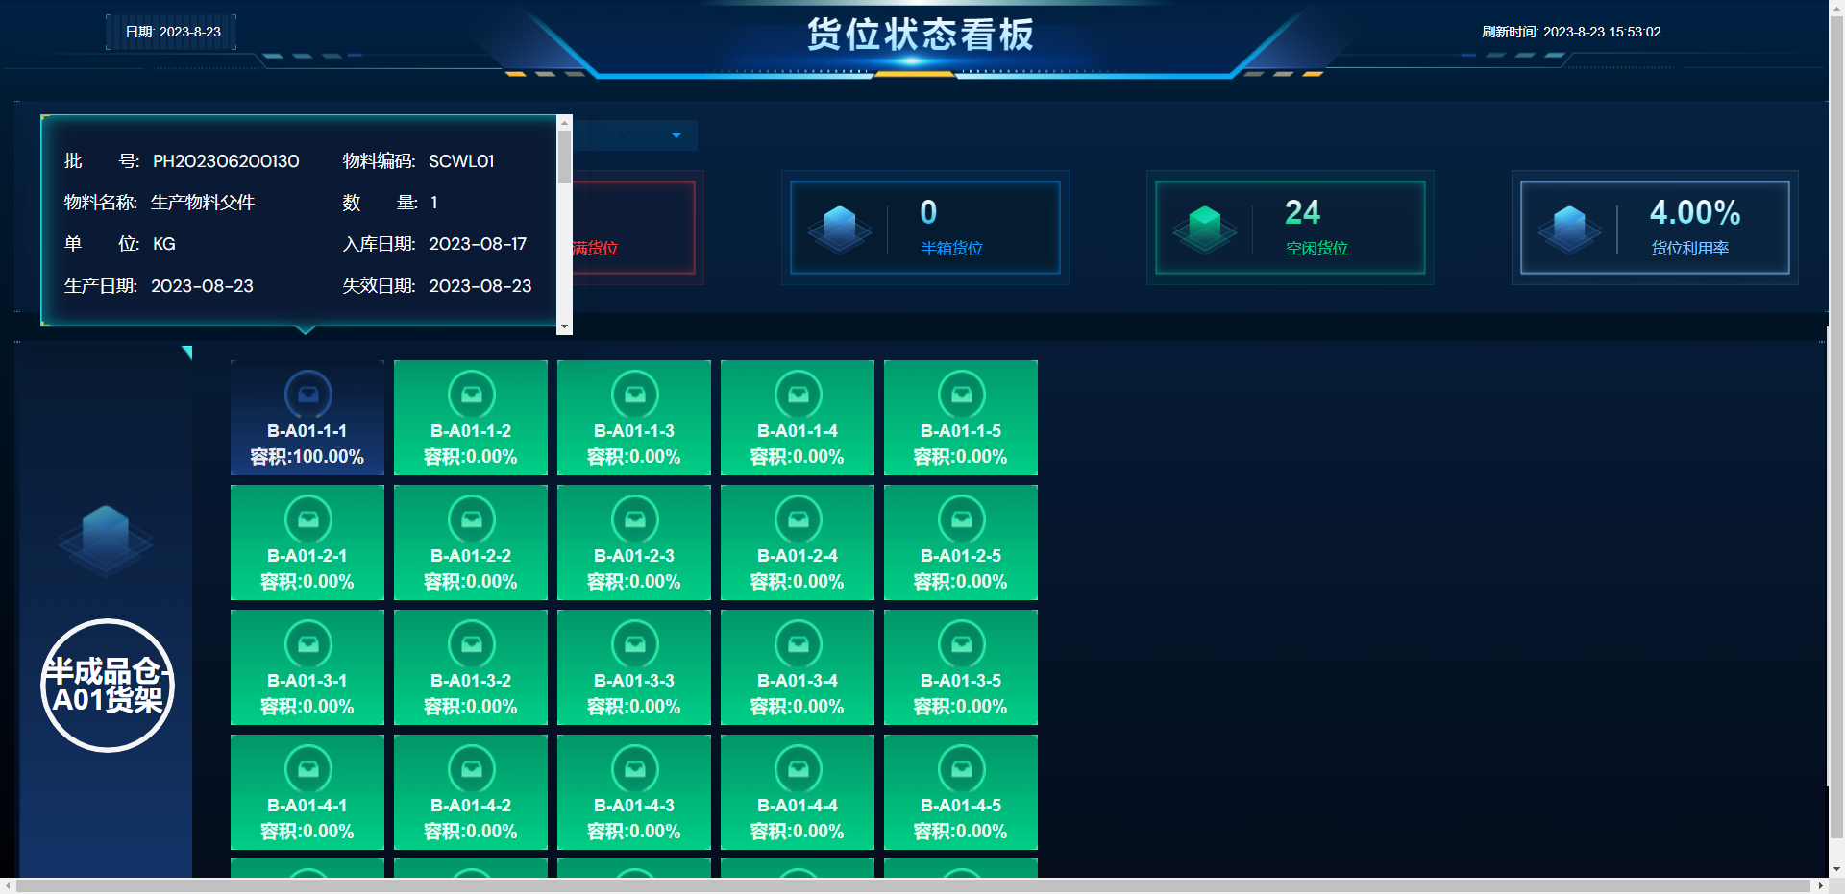
WMS Warehouse Monitoring Screen
Stock status signage
Displays the volumetric ratio of each cargo space under the warehouse. Can visualize the storage of materials in each bay.
Counting the number of free spaces, full spaces, half-boxes
Number of spaces. The utilization rate of the cargo space.
You can view the details of the materials stored in the cargo space.
1819

Slide 19
Thank you

