Slide 1
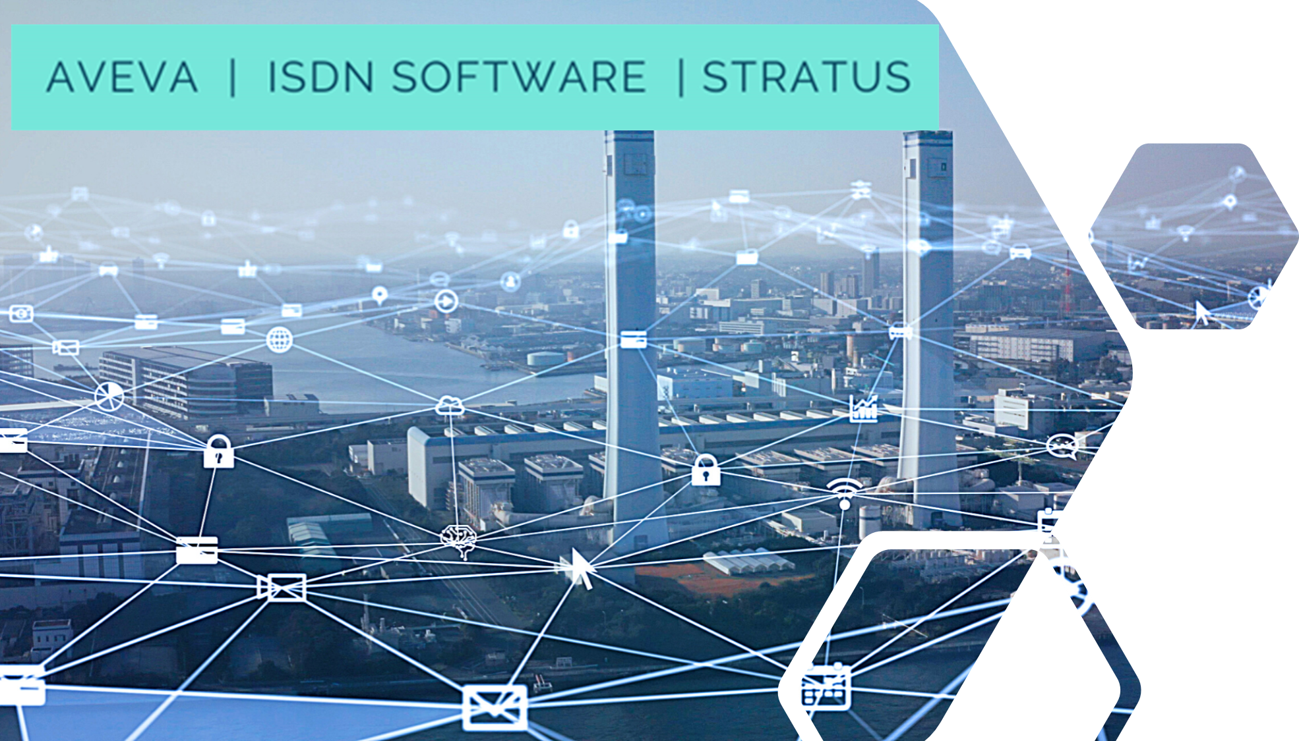
Industrial Innovation Challenge Competition Webinar Presentation 2

Slide 2
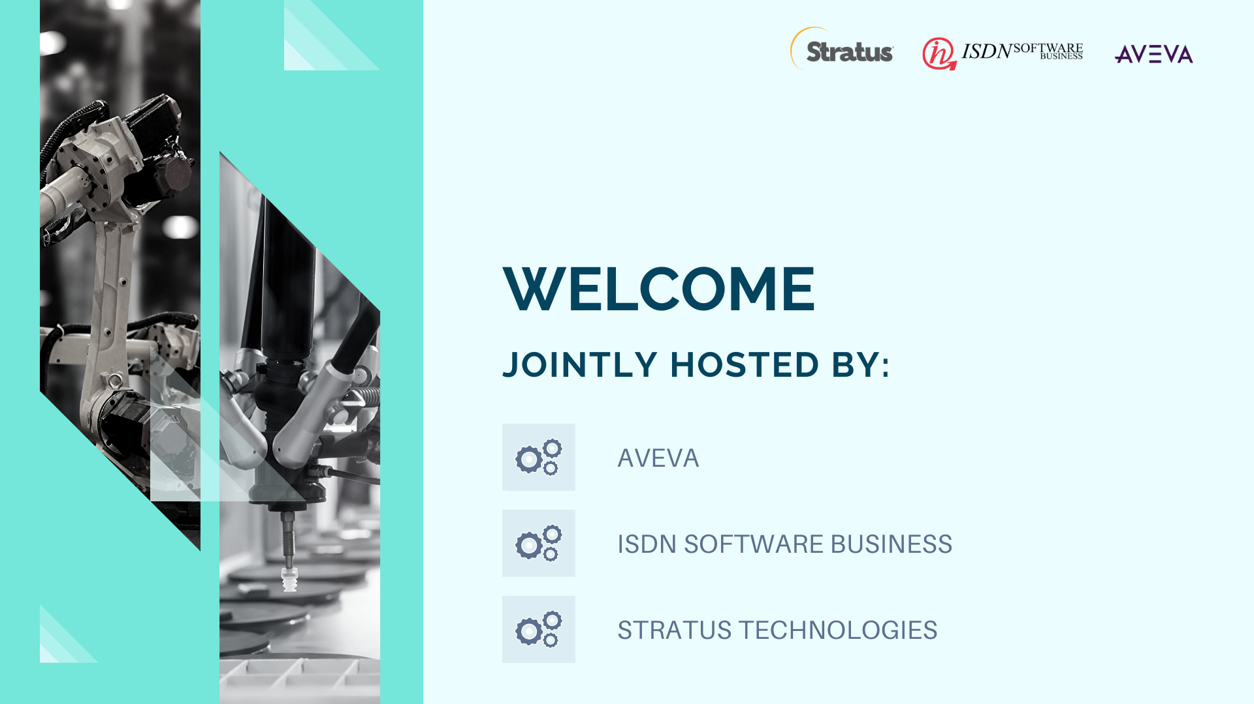

Slide 3

ISDN Industrial Innovation Challenge 2021
The Industrial Innovation Challenge 2021 seeks to get participants to apply their process design skills to solve real-world design problems. A unique opportunity to develop that experience while being mentored and supported through the entire competition by expert leaders from ISDN Software Business, AVEVA and Stratus Technologies

Slide 4
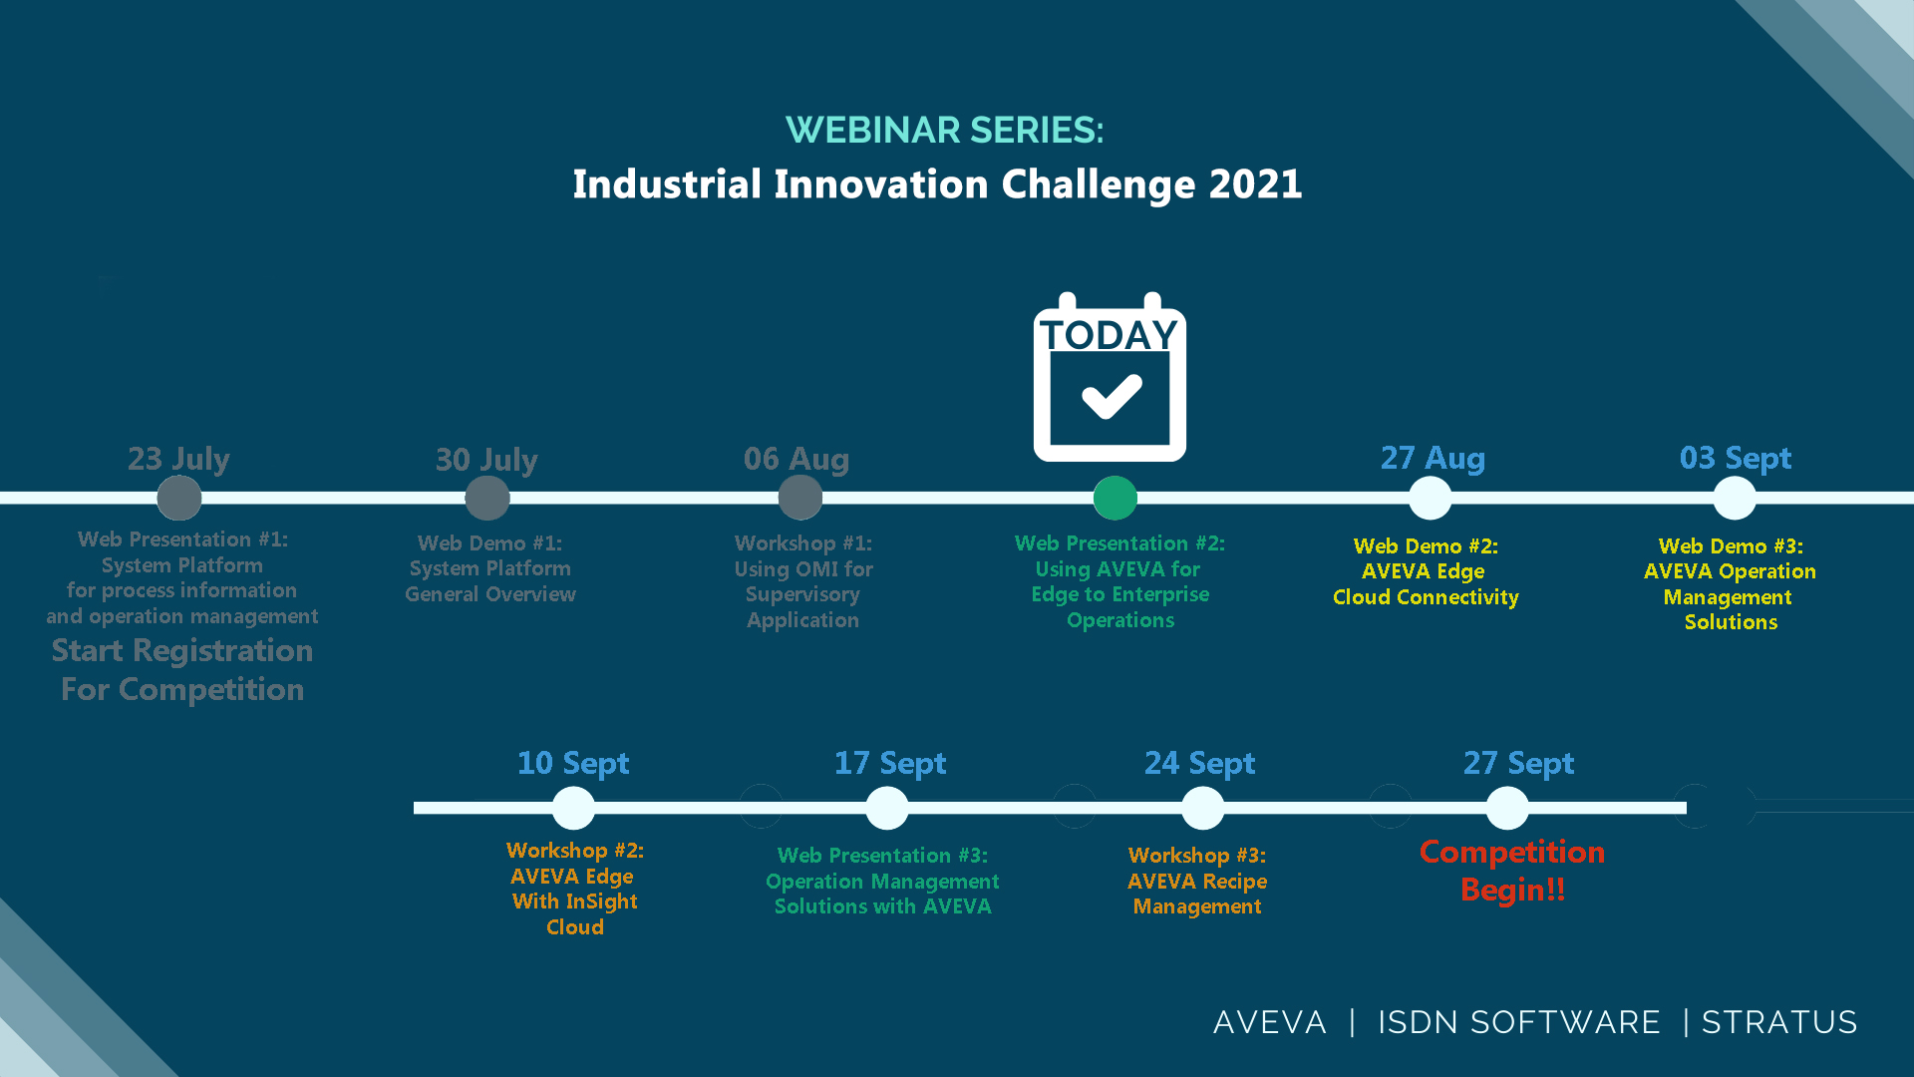

Slide 5

AVEVA Edge Overview and Stratus ZTC Edge

Slide 6



















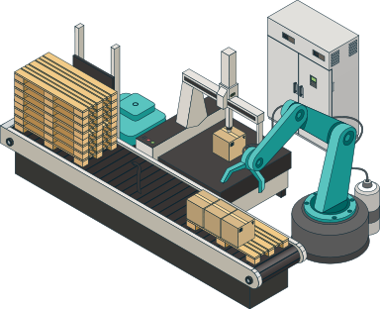


Edge to Enterprise
AVEVA
Insight
Control Room/Unified Operations Center
AVEVA
System Platform
AVEVA
Integration Studio
AVEVA
Connect
AVEVA
Application Server
AVEVA
InTouch HMI
AVEVA
Historian
AVEVA
Communications Drivers
AVEVA
Operations Management Interface
AVEVA
Edge
Across Enterprise
Asset Location

Slide 7

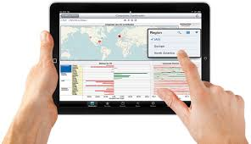
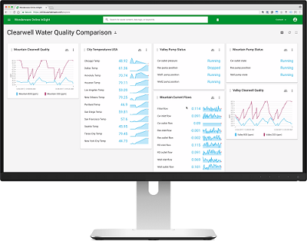
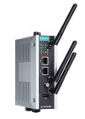
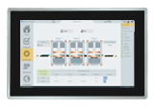


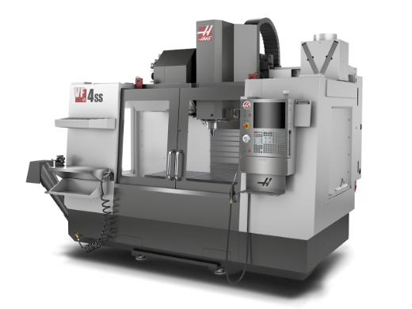

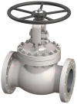
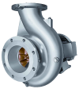
Industrial Internet of Things (IIoT) / Industry 4.0
AVEVA Edge as an IoT Gateway and/or HMI/SCADA node
CLOUD
Cloud Analytics and Mobile Access
analytics, consolidation, artificial intelligence (AI), machine learning (ML), remote management/deployment, remote notifications and monitoring
Premises
Edge devices
data acquisition, data manipulation (aggregations, filtering, contextualization, normalization), link with the cloud, local maintenance, local operation
Instrumentation and Controllers
operational real-time control, raw data measurements

Slide 8

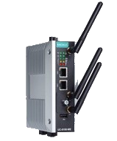

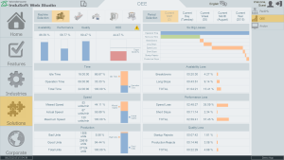
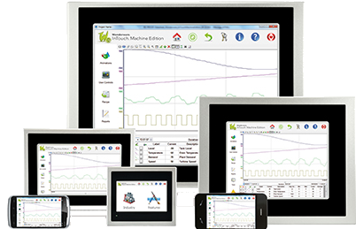

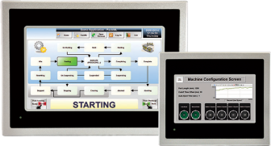
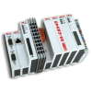
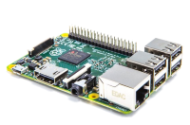




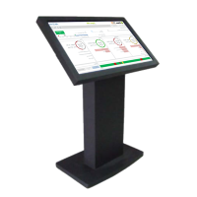







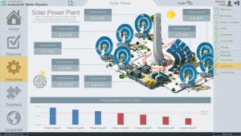

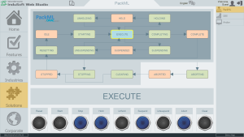






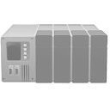

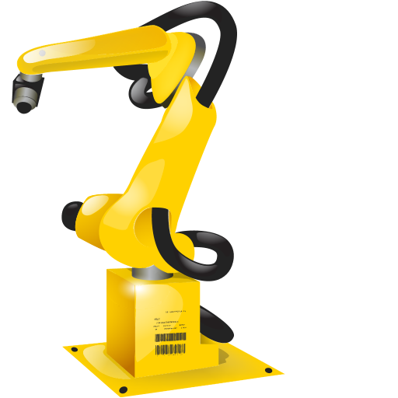




Main Benefits
Productivity
Reliability
Security
Portability
Mobility
Interoperability

Slide 9
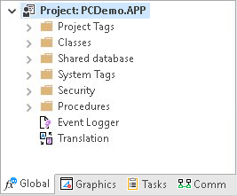
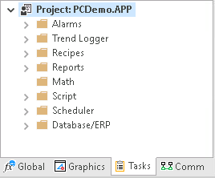

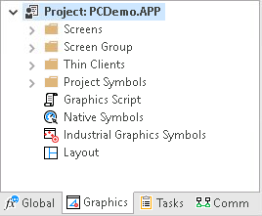
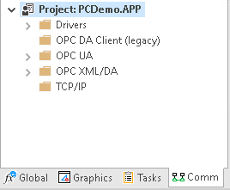

Native tools for SCADA, HMI, and IoT solutions
Comprehensive, Mature, Innovated and fully integrated

Slide 10

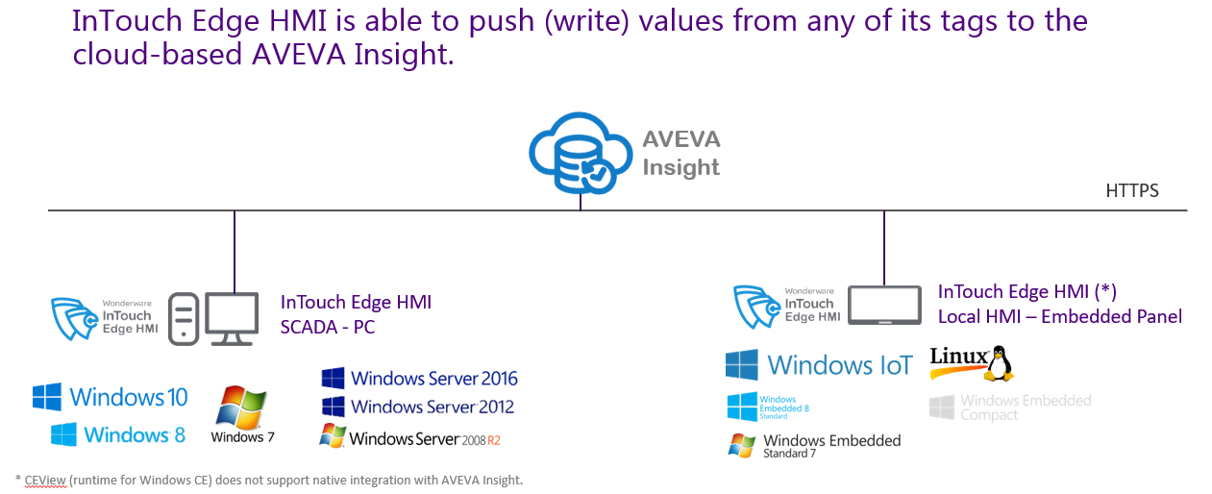
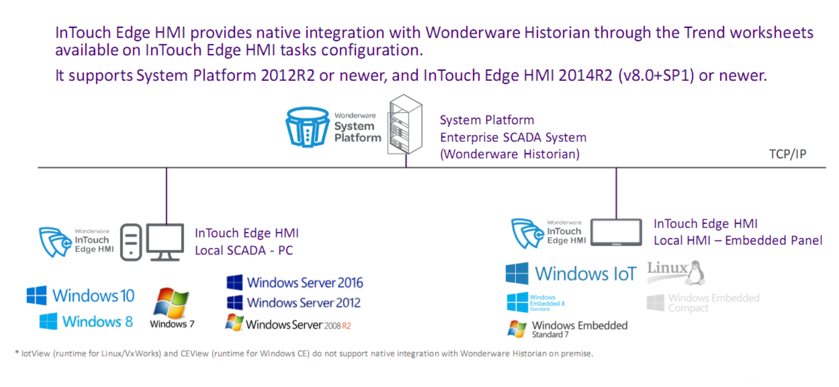
Native Integration with Historian / Insight
AVEVA Edge HMI Provides native integration with Wonderware Historian through the trend worksheets available on Edge HMI task configuration and is able to push values/data from any of its tags to the cloud-based AVEVA Insight

Slide 11
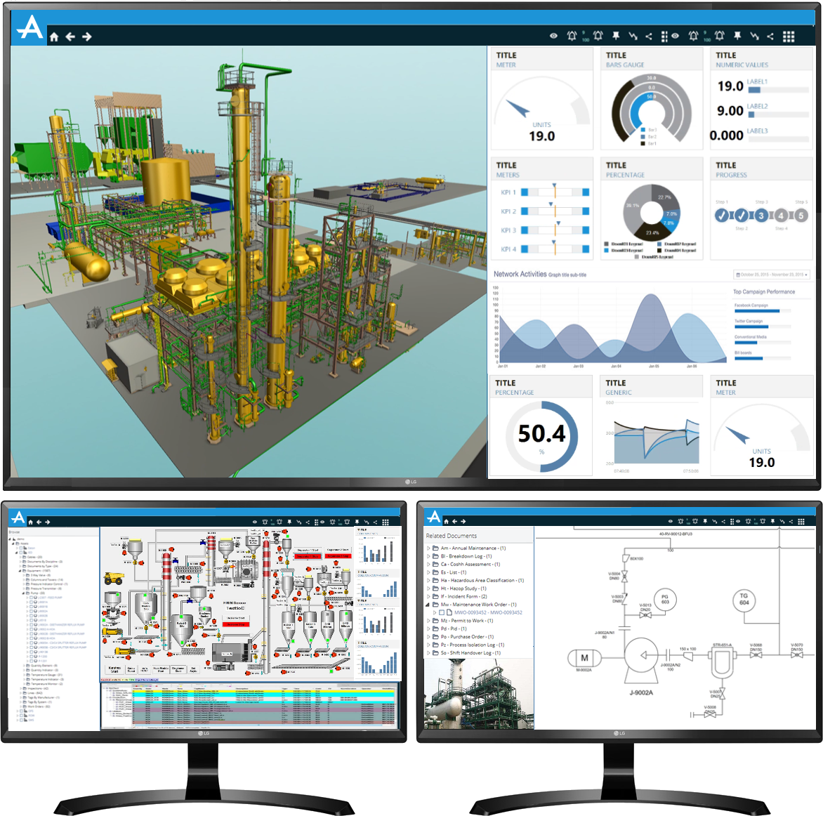
AVEVA System Platform – Unified Operation Center
System of System. Unifies all essential system services into a single robust platform. Integrating all edge subsystem in in a unify platform
Used to collect and analyze data with historians, intelligence and mobile reporting tools. Plug in MES, Batch & Workflow to streamline operation
Enterprise wide visibility across Operational and Business organization
An open and scalable foundation with centralized management to integrate and unify people, information, and processes with flexibility to rapidly adapt to business needs
Operational KPIs Status Indicators
3D Site
Overview
1D and 2D Viewers
InTouch OMI Navigation Tree
Live Process Graphics
Alarm Grid
“Live” camera feed

Slide 12



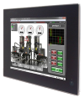

Edge to Enterprise solution made easy
Seamless integrated development environment
Support for Industrial Graphics and Galaxy Repository
Automatic point mapping
Event-driven communication (VTQ)
Synchronized Alarm Status
Native support for AVEVA Historian
Remote Management and Deployment
Native ITMEViewApp object for System Platform, MQTT SparkplugB and/or OPC UA integration options.
Enterprise SCADA
Unified Operation Center (UOC)
Control Room
AVEVA
System
Platform
AVEVA Edge
AVEVA Edge
AVEVA Edge
On Premise
Asset Level
AVEVA
Edge
AVEVA
Edge
AVEVA
Edge

Slide 13
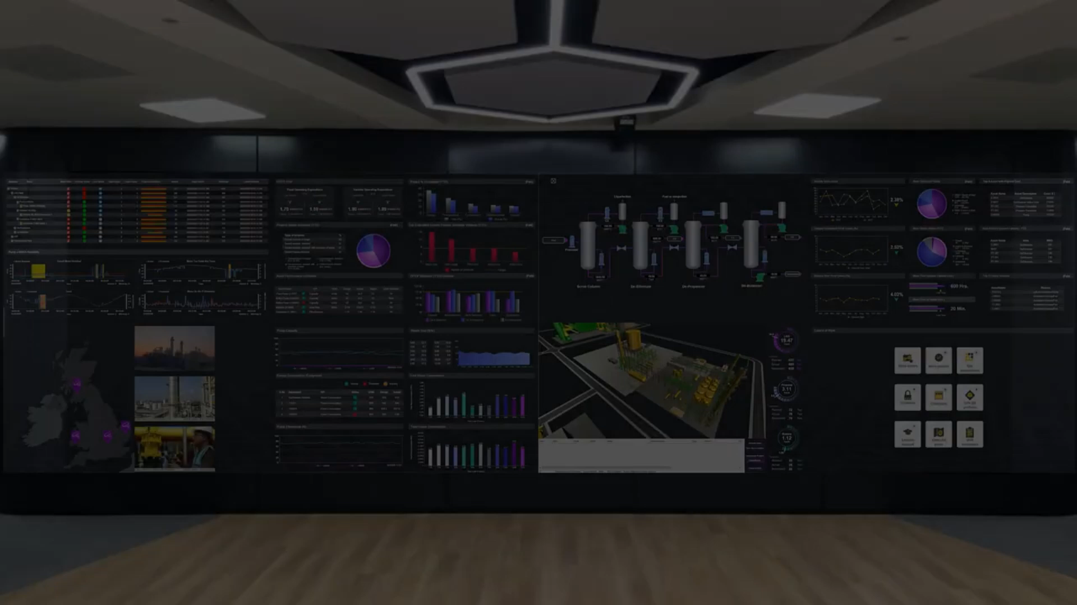

Slide 14
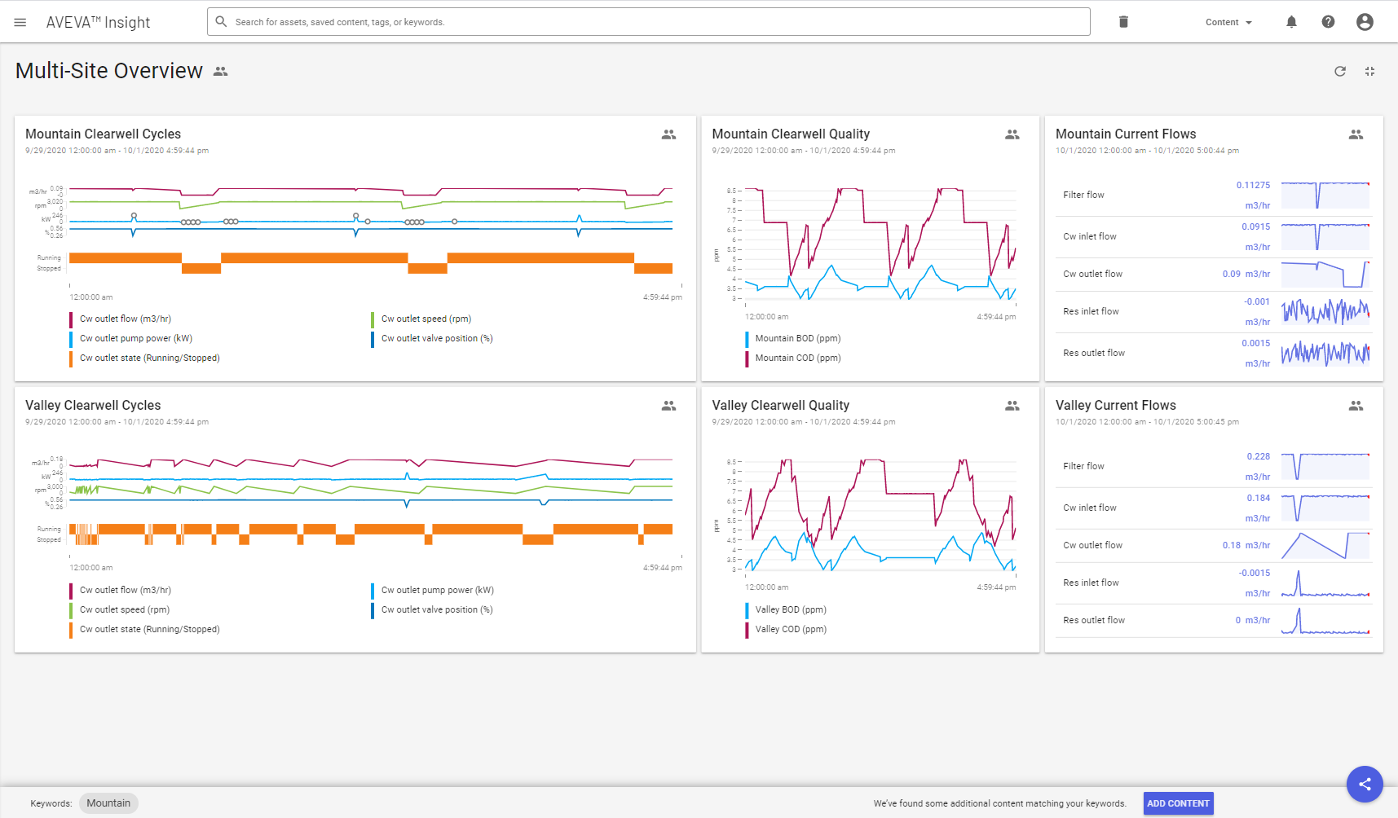
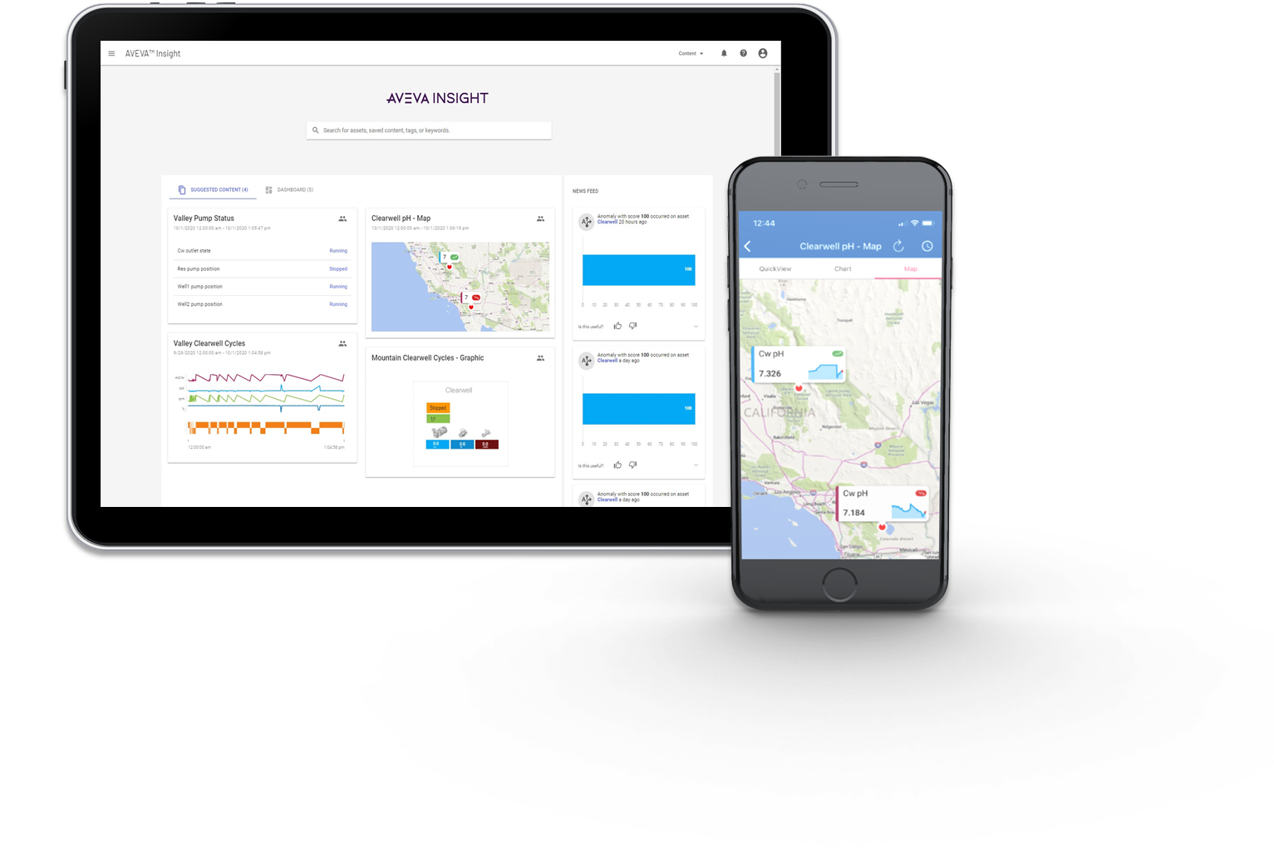
AVEVA Insight
AVEVA Insight provides information when and where you need it, so you and your teams, can better manage your assets and improve performance.
Unlock critical data
Increase collaboration
Improve asset reliability
Drive operational performance
Dashboards

Slide 15
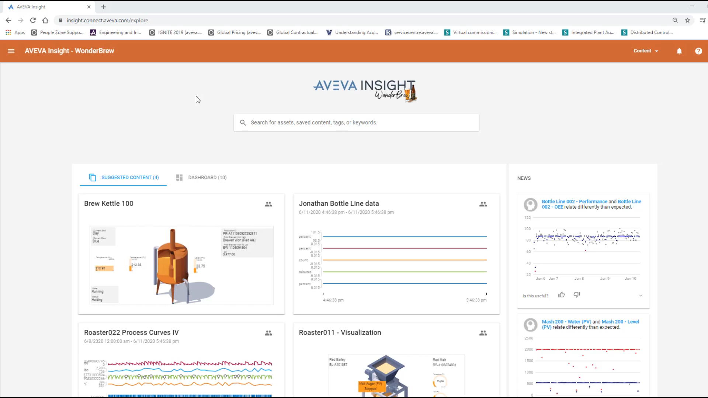

Slide 16



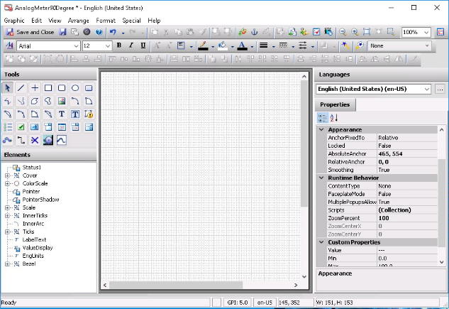
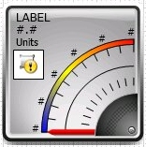
Common Graphics across Portfolio
Leveraging AVEVA Cloud to build & save graphics
Engineering Efficiency , Built Once!
AVEVATM Integration Studio
Common Technology across Large Customers using multi-products
AVEVATM System Platform
Concurrent Collaborative Development across teams / sites
AVEVATM OMI
AVEVATM InTouch HMI
AVEVATM Cloud Insight
AVEVATM Edge

Slide 17


